Slide 1

Elimination
Dr.Sundari Nandyala
Bangalore.
PG forum 21.5.23

Slide 2
Lay out of the topic
Magnitude of the problem
Causes for high prevalence of cervical cancer in India
Strategies to eliminate cervical cancer
Our role in cervical cancer elimination.

Slide 3
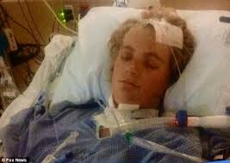

30 yrs. Old lady working in IT had an irregular bleeding and white discharge per vagina for 6 months.
She was diagnosed to have very small lesion on the cervix and biopsy conformed cancer cervix!!
Could not accept and wanted to have a child?
Tried Unani medicine for one year came back with advanced stage of cancer.
1yr of palliative therapy tried.
Could not live long!!

Slide 4
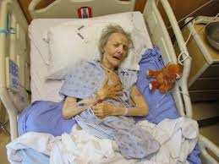

65 yrs. old uneducated woman presented with postmenopausal bleeding and foul smelling discharge. On examination she had advanced cervical cancer! Radio chemotherapy given.
Lived only for 6months??

Slide 5
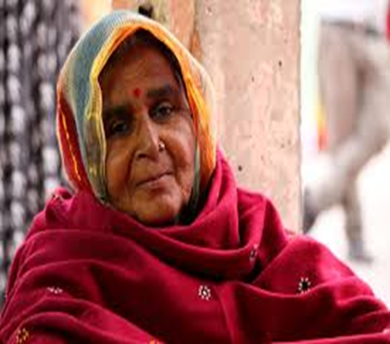
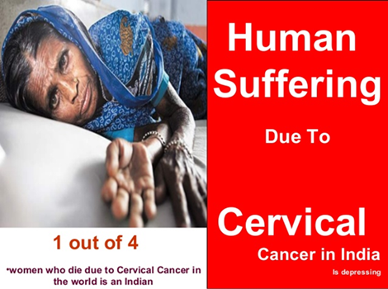

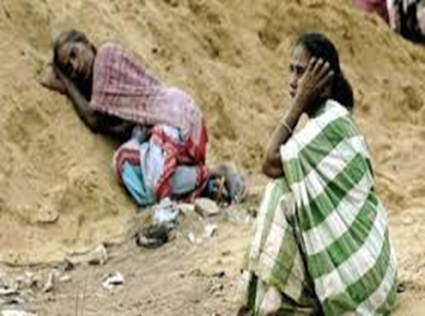
Indian scenario??
25% of world’s cervical cancer burden is in India!!!

Slide 6


As of 2018, two women die of cervical cancer each minute and the annual cervical cancer mortality exceeds maternal mortality (311 365 versus 303 000). These indices have led the World Health Organization (WHO) to announce the prioritization of the elimination of cervical cancer
The maternal mortality ratio has declined by 37%, since 2000.
There has been a 17% increase in absolute mortality from cervical cancer in less than a decade (from 275 000 to 311 365 per year).
Clinical Oncology Volume 31, Issue 8, August 2019, Pages 529-538

Slide 7

Cervical cancer is totally preventable virus induced sexually transmitted disease.

Slide 8


A global call
Eliminate cervical cancer!!!
2018

Slide 9
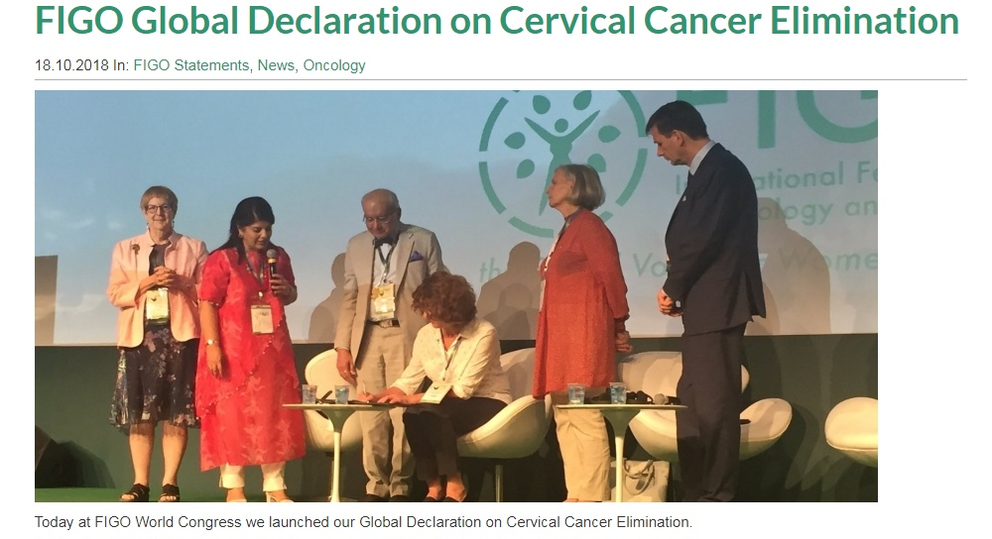

Slide 10

Are you aware of cervical cancer and its magnitude?
Global scenario: 2018
4th most common cancer in women.
5,70,000 women diagnosed every year.
3,11,000 deaths per year.
The estimated age-standardized incidence is
13·1 /100 000 women and varied from 2 to 75/ 100 000 women globally.
By 2050 > 1 million new cases of cervical cancer occur every year.

Slide 11

cervical cancer burden in India

Slide 12
Prevalence - India
2nd most common woman cancer.
1/5th of world cervical cancer burden is in India.
1,04,000 new cases per year.
Incidence is 14.7/100000 women.
60078 deaths per year in India (25% of world cervical cancer deaths.).
In urban areas 40% of all cancers is cervical cancer.
In rural areas it accounts for 65% of cancers.
National Institute of Cancer Prevention & Research
National Cancer Registry Programme of the Indian Council of Medical Research

Slide 13
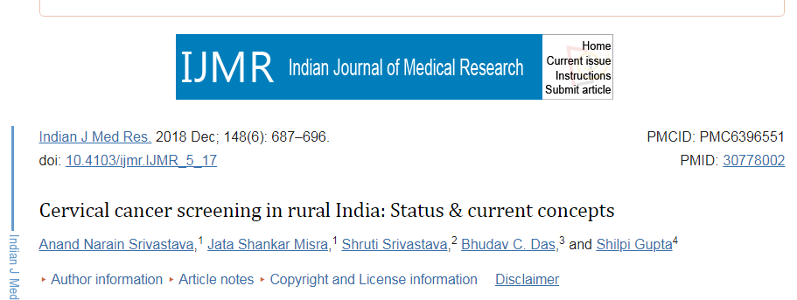
Cervical carcinoma is one of the most common and dreaded diseases of women, and in India, it accounts for 16 per cent of total cervical cancer cases occurring globally. The situation is more alarming in the rural areas where the majority of women are illiterate and ignorant about the hazards of cervical cancer.

Slide 14

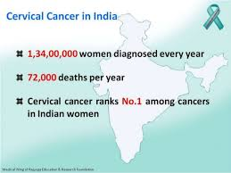
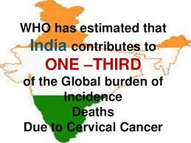
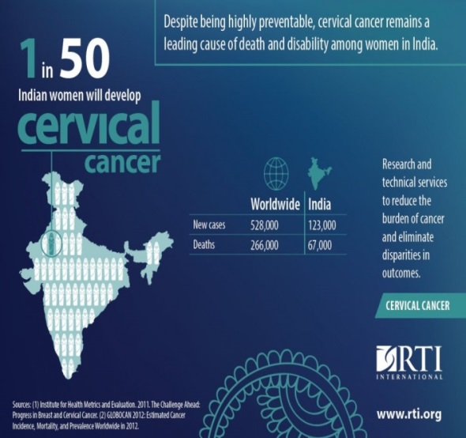
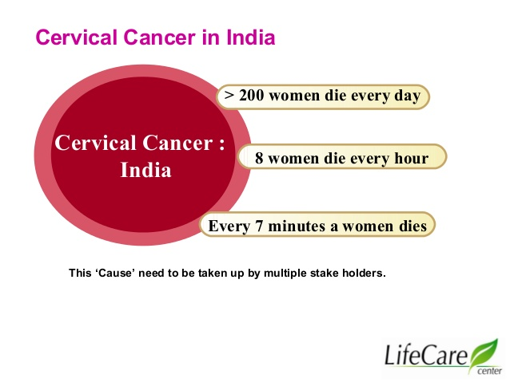

Indian scenario
India is the capital of cervical cancer.
Every 7 minutes one woman dies of cervical cancer in India!!
Biggest challenge in India

Slide 15


Slide 16
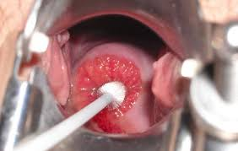

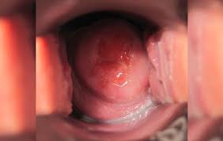
Major factor:
Lack of awareness among both educated & uneducated.
Cervical cancer
Every 8 minutes one woman dies of cervical cancer in India
Lack of commitment among health care providers.
Lack of Infrastructure.

Slide 17
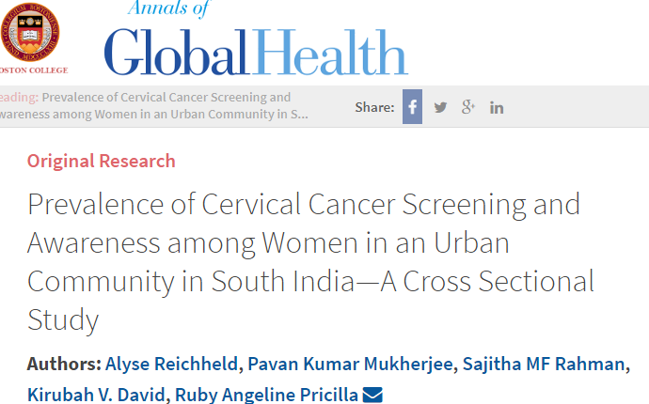
Survey in South India
Awareness
84.6% of women had poor knowledge.
10.3% had moderate knowledge.
5.1% had good knowledge.
7.1% had undergone cervical cancer screening

Slide 18

Why cervical cancer screening is not effective in India?

Slide 19
High prevalence of cervical cancer in India
Knowledge
Attitude
Practice
Infrastructure.
Medical facilities.
Awareness programmes.
Causes
Epidemiological factors
Poor socio-economic status.
Poor hygienic conditions .
Early age marriage and multiple pregnancy.
Indian J Med Res. 2018 Dec; 148(6): 687–696

Slide 20
Barriers for cervical cancer screening in India
Awareness
Awareness regarding cervical cancer & its prevention is almost NIL
Hesitancy & fear
Hesitancy to get the check up for the fear of cancer detection.
Illiteracy
Lack of proper education and cultural barriers.
Lack of family support
Discouragement for screening.
Lack of transport facilities
Financial constraint.
Barriers

Slide 21
Elimination of cervical cancer

Slide 22
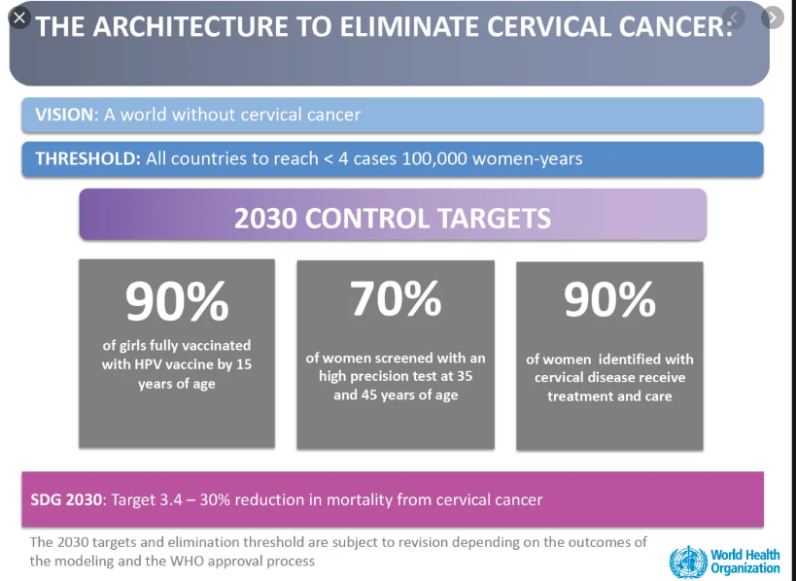
WHO strategies

Slide 23
Is it possible in India?

Slide 24


Is it possible in India??
Lancet oncology reports
India can eliminate cervical cancer by 2079
By primary & secondary prevention.
Rate of decline of cervical cancer is 3.8% per year.
Indian Express (March 26th 2019)

Slide 25
Practical difficulties In India
for 48.05% of female population accounts 675 millions.
68% of these females are in the age group of
15-64 yrs.
Cytology labs.
Cytologists.
Cost effective HPV DNA testing.
Expertise to interpret VIA results
Cost is the main barrier for implementing the best screening test.
Vaccine which is available is not affordable to all.
Huge population
Inadequate facilities for screening
Cost

Slide 26
Present scenario at various levels
GOVT
NCD project includes cervical cancer screening by VIA.
Except in a very few states, it is not implemented successfully.
Professional bodies
Lease importance is given.
Public
Very poor awareness.
Awareness among professionals is not adequate.
Involvement is lacking.
Concept of prevention & early diagnosis is far from reality.
Financial constraints.
Fear of cancer diagnosis.
Govt. is not serious about strict implementation.

Slide 27
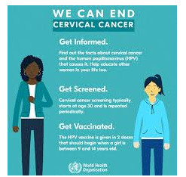
What needs to be done?
To create awareness among the public regarding the disease & its prevention.
To encourage
Vaccination of all girls of 12-14 yrs. of age.
To provide facilities for screening of women at affordable cost.

Slide 28
If women have adequate awareness & willingness to undergo screening
first step in elimination
will be
Successful

Slide 29
How to create awareness?

Slide 30

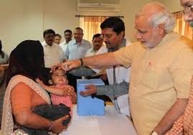
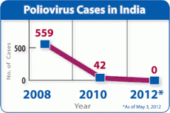
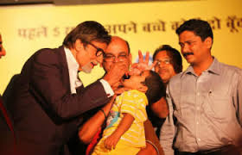

Success story of polio eradication in India

Slide 31
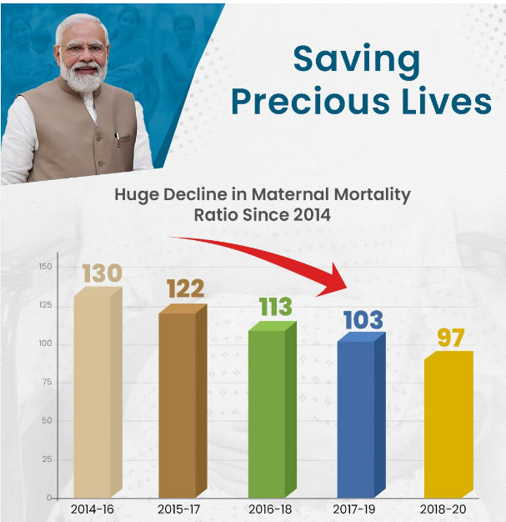
Success story of decline in MMR in India
GOVT involvement is pivotal

Slide 32
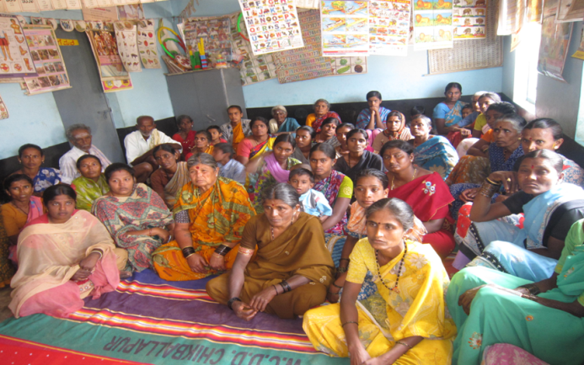

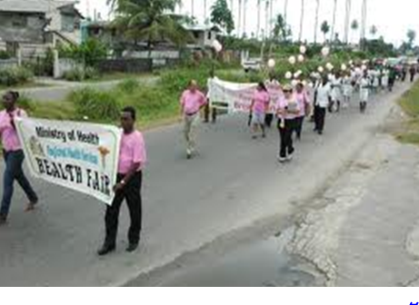

Creating public awareness
Awareness talks for rural women
Film on cervical cancer awareness
Media
Awareness in villages

Slide 33




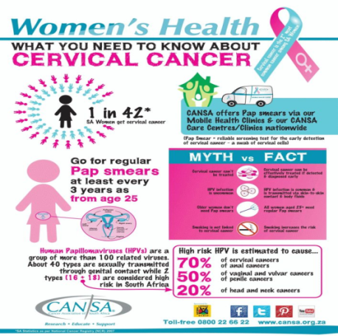


Pamphlets
Talks
Messages
Posters
posters
Walkathon & street play

Slide 34
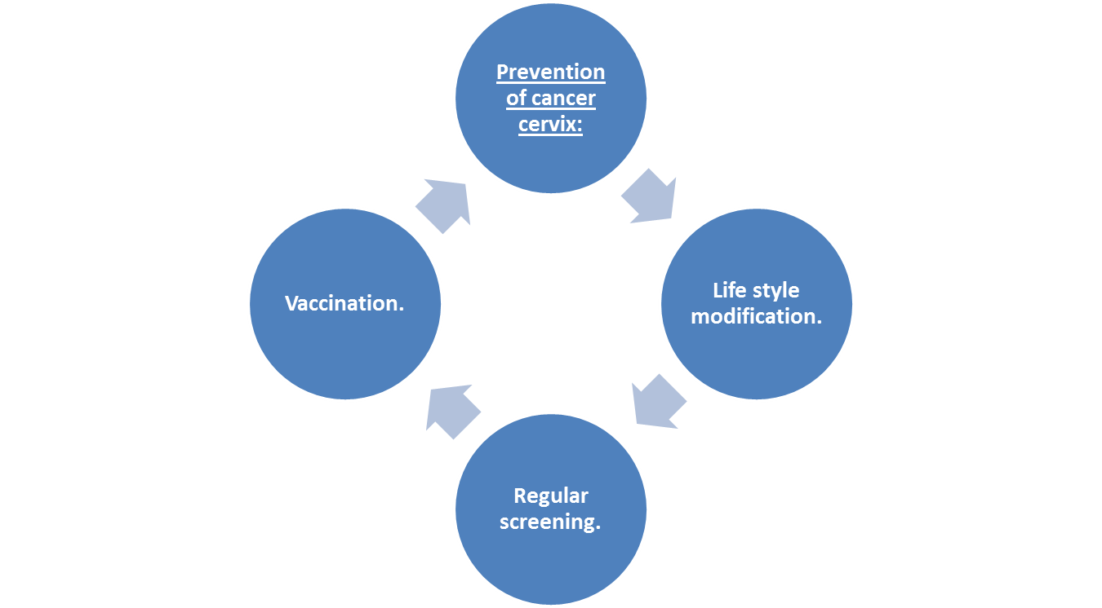
Primary prevention
Secondary prevention

Slide 35


Primary prevention
HPV vaccination has the potential to reduce cervical cancer incidence around the world by as much as 90%.
WHO now recommends:
A one or two-dose schedule for girls aged 9-14 years
A one or two-dose schedule for girls and women aged 15-20 years
Two doses with a 6-month interval for women older than 21 years.
Indigenous vaccine
Cervavac –quadrivalent vaccine
2 doses for 9 -14-year age group.
3 doses for 15-26yrs. age group
Types of vaccine.
Only Gardasil is available all over the world.
Quadrivalent vaccine.
Nonavalent vaccine.
Below 15 yrs. only two doses of vaccine to be given
Single dose is found to be effective!!
Dose schedule:
2 or 3 doses for immunocompromised women.
Primary targets is girls of 9-14yrs.
Secondary targets are older girls & boys.
Who should not have vaccine:
1.Children below 10 yrs. .of age.
2.Pregnant women.
3.Women who are known to have allergy to vaccine.

Slide 36
WHO latest recommendation (11.04.22)
One-dose Human Papillomavirus (HPV) vaccine offers solid protection against cervical cancer
11 April 2022 News release - WHO
WHO Strategic Advisory Group of Experts on Immunization (SAGE) evaluated the evidence
SAGE recommends updating dose schedules for HPV as follows:
one or two-dose schedule for the primary target of girls aged 9-14
one or two-dose schedule for young women aged 15-20
Two doses with a 6-month interval for women older than 21.
Immunocompromised individuals, including those with HIV, should receive three doses if feasible, and if not at least two doses. There is limited evidence regarding the efficacy of a single dose in this group.

Slide 37
Recommendation for individuals beyond 15yrs of age.
15-26yrs:
ACIP recommends vaccination for everyone through age 26 years if not adequately vaccinated when younger.
26-45yrs:
The new study, undertaken using mathematical models—from Harvard and Cancer Council New South Wales, Australia indicates
HPV vaccination of people in this age range provides less benefit, for several reasons, including that more people in this age range have already been exposed to HPV.
HPV vaccines for adults over age 26 may not be cost effective
https://www.hsph.harvard.edu/news/press-releases/hpv-vaccines-for-adults-not-cost-effective
https://www.cdc.gov/vaccines/vpd/hpv/hcp/recommendations.html

Slide 38
Secondary prevention.

Slide 39
Secondary prevention
Life style modification
Screening

Slide 40
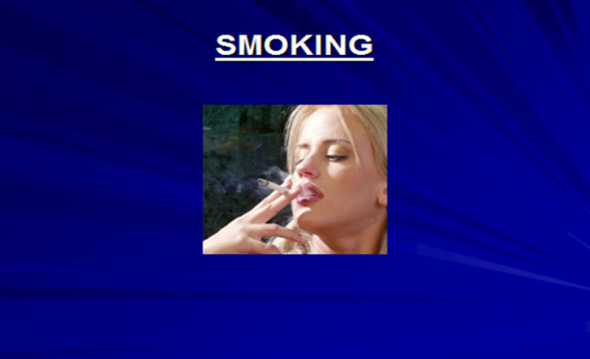





To avoid
Indulgence in sexual activity at an early age.
Multiple sexual partners.
Smoking
Early age conception.
Excess weight gain.
Multiple pregnancies.
Say no
Exercise
Have right diet habits.

Slide 41

Resource based cervical cancer screening recommendations.
Components | Good Resource Settings | Limited Resource Settings
Method of testing | HPV DNA testing Cotesting, VIA,LBC,Pap Colposcopy+ biopsy. | VIA Colposcopy+ biopsy.
Target age for screening | 25-65yrs. | 30-65yrs.(Not suitable for PM women).
Starting age | Cytology / Primary HPV Testing at 25yrs. Co-testing at 30. | 30yrs.
Frequency | HPV Testing or Co-testing - 5 years Cytology –once in 3 years. | Every 5 years (at least 1-3 times in a lifetime).
Age to stop (years) | 65yrs if previous reports normal. | Screen at 65yrs if no previous screening & stop.
Follow up after treatment | HPV DNA or cytology-12 months. | VIA after 12 months.
Screening after abnormal smear | For 20yrs.
Post hysterectomy | No screening if no prior cervical | lesions.
CIN in hysterectomy specimen | HPV DNA testing at 6 months and | 18 months.
Women who have been vaccinated also need screening
screening protocols for them?

Slide 42
HPV DNA testing
Conventional Pap smear
VIA; Villi
Automated cervical screening techniques
Auto pap 300.
Methods
of
screening
Neuromedical systems. PAPNET.
Automated visual evaluation
Liquid based cytology
Biomarkers.

Slide 43
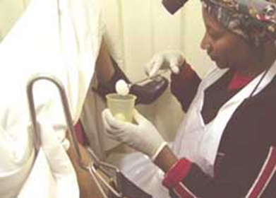
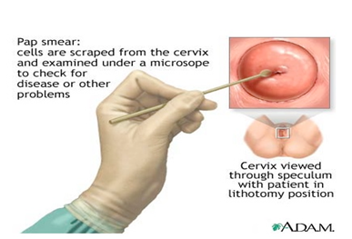
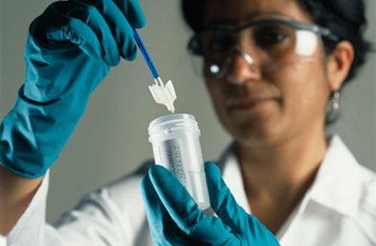
Various screening modalities have been recommended for cervical cancer screening
VIA
Pap smear
HPV DNA

Slide 44
Low sensitivity 54.4%
High specificity 98.6%
Subjective
False negativity 5-15%
LBC overcomes the conventional pap limitations.
Computer assisted pap smear analysis reduces the burden on cytologists.
Objective test
Eliminates subjective errors.
Sensitivity- 63.6%s
Specificity 96.28%
Screening interval can be prolonged.
Latest recommendation is twice screening between 35-45 yrs. of age.
Subjective
Result depends on performer’s experience.
Low specificity
Unnecessary interventions.
Not suitable for post menopausal women
Advantages:
No cost .
Learning curve is short.
Health care workers can be trained.
Screen & treat is possible
Pap smear
HPV DNA test
VIA test

Slide 45
HPV infection clearance pattern
HPV infection
Persists-20%
>30yrs.
Transient & clears- 80%
Adolescents & young adults
LSIL
20%
Infection clearance
Lesion regression
HSIL
20%
Invasive cancer

Slide 46
Biomarkers
Advantages Disadvantages
E6 E7 mRNA
Specificity & PPV are more than HPV DNA testing
Cost is high
Viral oncoproteins are
needed for progression of premalignant lesions to carcinoma.
False positivity of HPV DNA is eliminated.
Not suitable as a primary screening modality
Over expression denotes definite malignant transformation
Expressed as positive or negative.
Useful as triage of LSIL & ASCUS positivity.
Detects 5 genotypes of virus 16,18,33,34,&45.
Nucleic acid amplification testis done using cervical specimen.
Follow up of women after treatment of premalignant lesions.
Indicates persistence and progression of the lesion after treatment.
Detects HPV infection and simultaneously predicts the change of cervical lesions . Continuous expression of E6/E7 onco genes is necessary for the development and maintenance of the dysplastic changes.
serve as a more specific discriminator between transient cervical dysplasia and potentially progressive lesions

Slide 47
P16 :Cell cycle dependent protein kinase inhibitor negatively regulates cell cycle. Associated with Pre cancer & cancer
Present in both normal & abnormal cells.
Expressed in nucleus & cytoplasm
Inactivates the CDK that phosphorelates the Retinoblastoma (pRb) protein.
Over expression indicates persistence of HPV infection
Ki67 nuclear antigen detected except in G0 phase of cell cycle.
Associated with HSIL & SCC
Expressed by proliferating cells and is a marker of cell proliferation. Present only in nucleus
Predictive & prognostic indicator of cancer & pre cancer. Positive in metaplasia, regenerating epithelium & HPV infection.
Mol Med Rep. 2015 Mar;11(3):1566-72. doi: 10.3892/mmr.2014.2914.
Oncol Lett 2019 Aug;18 (2) 1351-1355.

Slide 48
P16 /Ki67
Normal cervical cell do not express both p16 & Ki67. Co expression indicates cell cycle deregulation by HR HPV DNA & high grade lesions. Expression level correlates with the degree of the cervical lesions.
P16/Ki67 dual staining cytology is a biomarker for High grade CIN & SCC
Positive dual staining is associated with 16 & 18 HR HPV infection
Slides which show one or more cervical cells with dual staining are classified as positive regardless of morphological appearance of the cells.
J Cancer 2019; 10(12):2654-2660. doi:10.7150/jca.32743 Application of p16/Ki-67 dual-staining cytology in cervical cancers

Slide 49
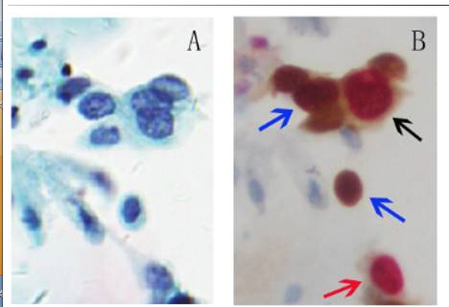
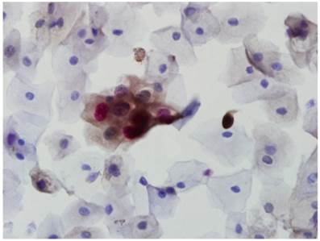
Dual staining cervical cytology
A: LBC
B: dual stain with p16 & Ki-67
Blue - stain for p16 alone Shows brown cytoplasm / nuclear signals.
Red Ki-67staining showing
red nuclear signal.
Black dual staining for
p16 & Ki-67 shows brown cytoplasm and red nuclear signals.
J Cancer 2019; 10(12):2654-2660.
Application of p16/Ki-67 dual-staining cytology in cervical cancers

Slide 50
Clinical application
HPV positive woman with 16,18, negative pap-Dual staining helps for further management
To differentiate high grade lesions from benign mimics
Metaplasia, atrophy, regenerating epitheliunm.
Triage of LSIL/ASC-US: Women with ASCUS and LSIL have a 2.6% and 5.2% 5-year risk for CIN3+, respectively. dual staining is more suitable.
Monitoring for recurrence after treating CIN 2 & 3
(Presently HPV & cytology are used )
To confirm cytological lesions of glandular abnormality.
LAST
LSIL & HSIL
Dual staining helps in triaging CIN 2 lesions (HSIL)
Reduces the referral to colposcopy & biopsy
J Cancer 2019; 10(12):2654-2660. doi:10.7150/jca.32743
Application of p16/Ki-67 dual-staining cytology in cervical cancers
Li Yu^{1,} , Lingyan Fei¹, Xubin Liu¹, Xufang Pi¹, Liantang Wang¹, Shangwu Chen²

Slide 51
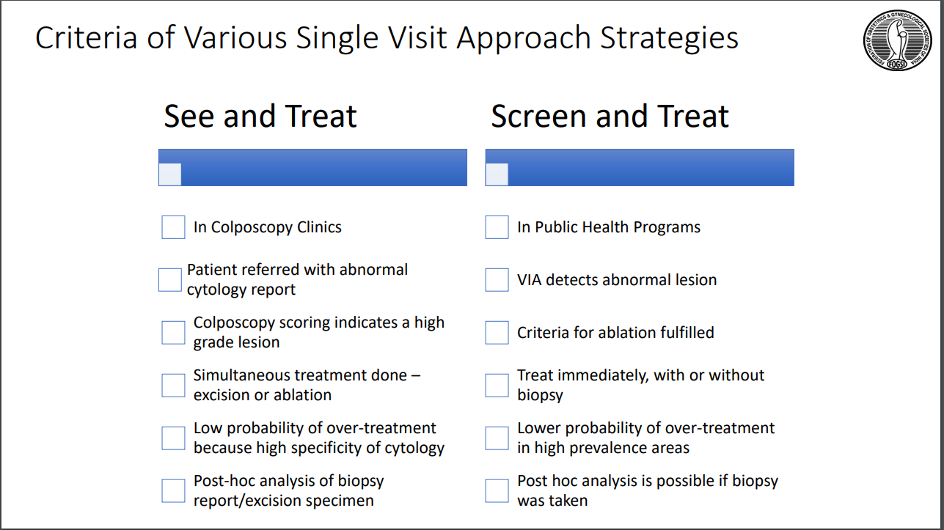

Slide 52
What is our role?
Your role?
Eliminating cervical cancer??

Slide 53
Take vaccine
Get the screening done if you are eligible.
Reach out to as many women as possible.
Family members, relatives, friends & neighbors.
Organize camps, awareness talks in schools, colleges, women organizations and IT companies.
Your role

Slide 54

Creating awareness is a marathon task, but it will definitely have positive impact on the public.
What will be the impact of all these?

Slide 55


Working towards elimination of cervical cancer
Adopt one or two villages
Create awareness
Every one
Together we can
Dedicate 2 days in a month for this social cause
Conduct screening
once a month

Slide 56
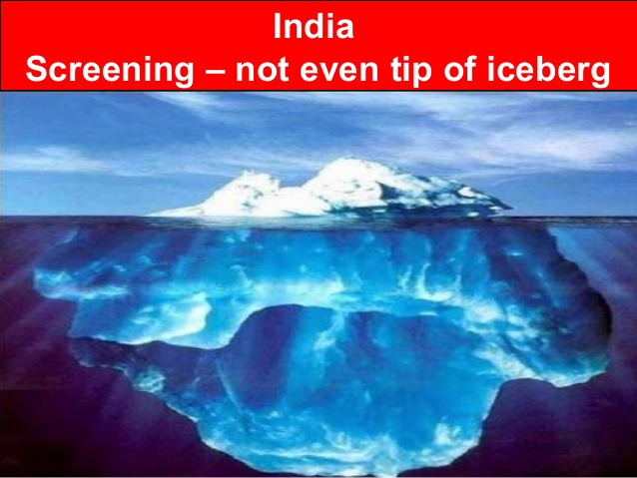

Slide 57
Each health system should develop its own screening protocols suitable to its country.
Afr Health sci. 2011 Mar; 11(1): 48–57: M Urasa^{1,2} and E Darj
WHO has recommended its member countries to develop and integrate cervical cancer screening into their health systems depending on the local social, cultural and economic contexts. This will ensure a defined referral system for diagnosis, treatment and follow up.

Slide 58





Slide 59


A long way to go

Slide 60

Strive to achieve the unachievable

Slide 61
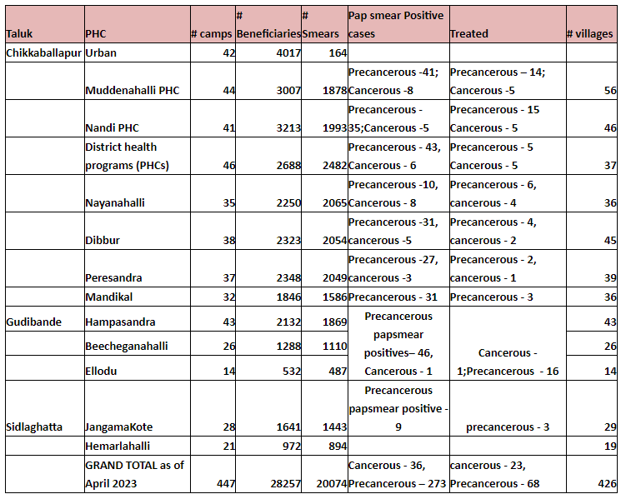
Mahati trust statistics

Slide 62
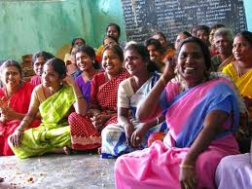
Thank you all

Slide 63
