Slide 1
Model answers
November 2017

Slide 2
Question 1
Enumerate the causes of vault prolapse (4).
Write a short note on management of vault prolapse(6)

Slide 3
Etiology of Vault Prolapse - Multifactorial
Pregnancy
Vaginal childbirth
Aging
Menopause
Chronically increased Intra abdominal pressure
Prior surgery
Trauma
Genetic factors
Race
Chronic diseases
Musculoskeletal diseases
Smoking & COPD
Prior surgery

Slide 4
Vaginal Birth as a cause of Prolapse
Macrosomia
Prolonged Second stage
Perineal tears
Instrumental delivery
Damage to muscles, fascia and nerves

Slide 5
Management of vault prolapse
Vault Prolapse is due to failure of Level 1 support.
Can happen with Uterus in situ or follow a Hysterectomy
Defined as descent of vaginal vault to a point 2cm less than the total vaginal length
Management – Conservative or Surgical
Conservative – PFMT ( pelvic floor muscle training), Pessaries
Surgical – Obliterative / Definitive
Obliterative – Lee Fort’s Colpocleisis

Slide 6
Definitive surgeries for Vault Prolapse
Route – Abdominal / Vaginal
Technique – Laparotomy/ Laparoscopy/ Robotic
Associated continence surgeries (repairs)

Slide 7
surgeries for Vault Prolapse with Uterus
At Vaginal Hysterectomy - Mc Call Culdoplasty – Anchoring posterior vaginal vault to Uterosacral ligaments
Modified Manchester repair
Sacrospinous Hysteropexy – Fixing Cx/ Uterosacral lig/ posterior vaginal wall to Sacrospinous ligament
Sacral Hysteropexy – Fixing the vault to sacrum using a mesh (LSH)
Sling surgeries
Laparoscopic Uterosacral Hysteropexy ( LUSH)

Slide 8
Surgeries after Hysterectomy
Sacrospinous Fixation (SSF)
Uterosacral ligament fixation – to proximal end of US lig – Abdominal/Laparoscopic/
Advantage of laparoscopy – direct visualisation of the ureter/ peritoneal relaxing incisions to prevent kinking of ureter
Use of Mesh – Apogee/ Perigee/ Mesh for Sacral colpopexy

Slide 9
Question 2
2. Describe the lymphatic drainage of vulva (2).
Enumerate management of VIN (4).
Staging of vulval cancer (4)

Slide 10
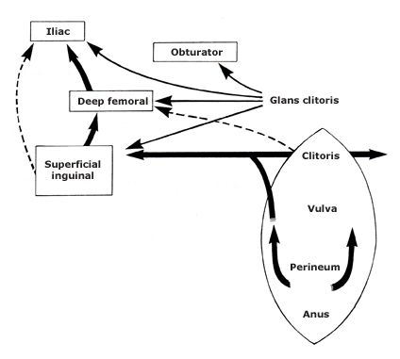
LYMPHATIC DRAINAGE OF VULVA

Slide 11
Lymphatic drainage of Vulva
Anterior trunk which runs lateral to clitoris from Perineal body, labia majora
At the mons veneris, they diverge laterally to the inguinal nodes
The vulval lymphatics also anastomose with the lymphatics of the lower third of the vagina, which drain into the external iliac nodes.
Primary lymphatic drainage is usually to the superficial inguinal nodes ➤ through the cribriform fascia to the femoral nodes ➤ external iliac nodes.

Slide 12
Lymphatic drainage of Vulva
The lymphatic drainage of the perineum, clitoris, and anterior labia minora is often bilateral whereas the lymph flow from well-lateralized sites (>2 cm from midline structures) in the vulva is predominantly to the ipsilateral groin.
In carcinomas of the clitoris and Bartholin’s gland the femoral LN can be involved without involvement of Ing LN
With lateralized primary tumors, metastases to the contralateral groin in the absence of ipsilateral groin metastases may be seen in up to 15% of patients with very advanced primary disease.
Pelvic node metastasis is extremely rare in the absence of groin node metastases

Slide 13
Enumerate management of VIN (4).
Initial assessment should consist of multiple biopsies to ensure that the lesion is entirely intraepithelial.
Patients with multifocal lesions should have biopsies from multiple sites
Once diagnosed,
Lesions of the lateral aspect of the vulva - superficial local excision of the vulvar epithelium with a 0.5–1.0 cm margin.
Lesions involving the labia minora - local excision or laser vaporization. Laser treatment of the hair-bearing skin of the vulvar epithelium will usually produce depigmentation and destruction of hair follicles with subsequent loss of hair growth.
Lesions involving clitoris - Laser vaporization.
Topical immune response modifier, imiquimod can also be used with good results
Large lesions - skinning vulvectomy and split-thickness skin graft.

Slide 14
Staging of Vulval Cancer

Slide 15
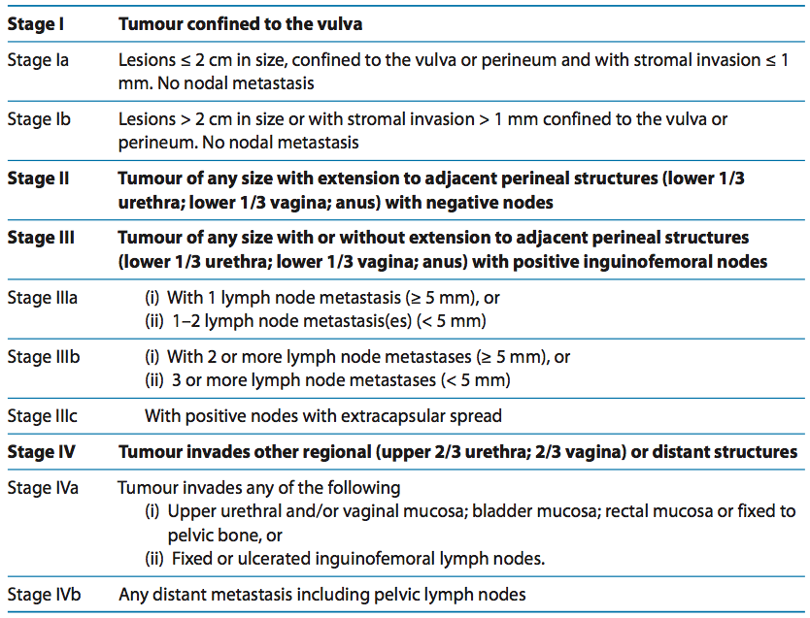
Staging of Vulval Cancer

Slide 16
3. Enumerate obstetric outcome of septate uterus (3)
4. Indications and steps of fothergill operation (4)

Slide 17
Reproductive outcome in Septate Uterus
Partial lack of resorption of the midline septum results in fibromuscular defects – septum
Infertility
Spontaneous Miscarriage – RPL
Preterm labour
FGR
Malpresentations
Inco-ordinate labour
Cesarean section

Slide 18
Causes for poor Reproductive outcome
Poor decidualisation & Placentation
Un coordinated Myometrial activity
Uterine cavity was mainly distorted by the reduced length of the unaffected uterine cavity rather than increased length of septum.
Septal implantation increases with increasing ratio of septal size to functional cavity

Slide 19
What's the distension medium used in hysteroscopy(4)
What are precautions to be taken in hysteroscopic polypectomy(6)

Slide 20
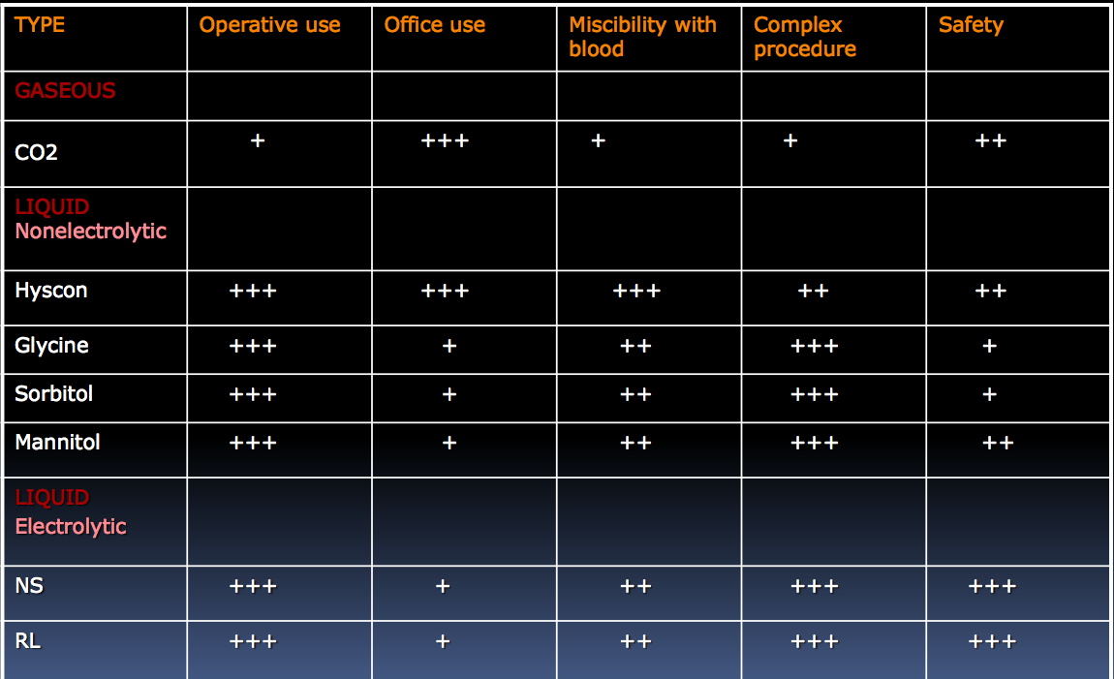

Slide 21
precautions to be taken in hysteroscopic polypectomy
Pre-op evaluation
Size and the Volume
Localisation of polyp
Number
Degree of Intramural affectation(protrusion into cavity)
Classification
Endometrial biopsy

Slide 22
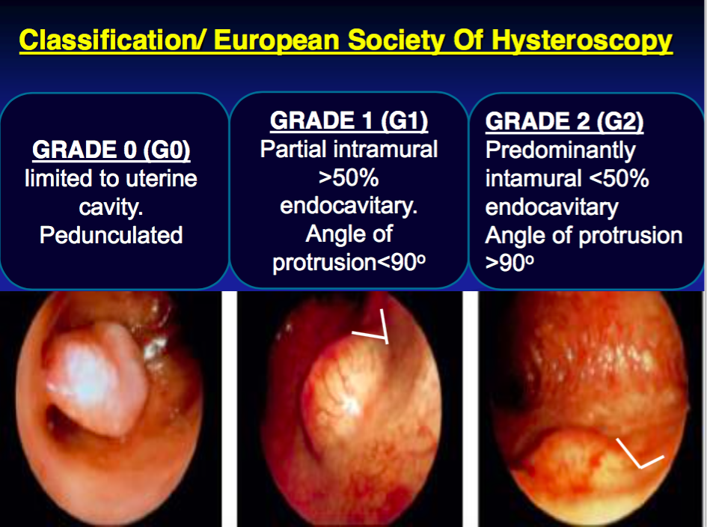

Slide 23
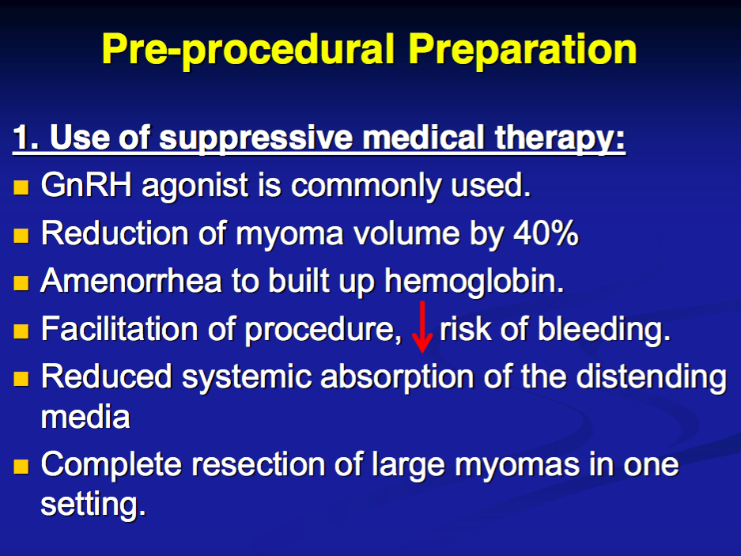

Slide 24
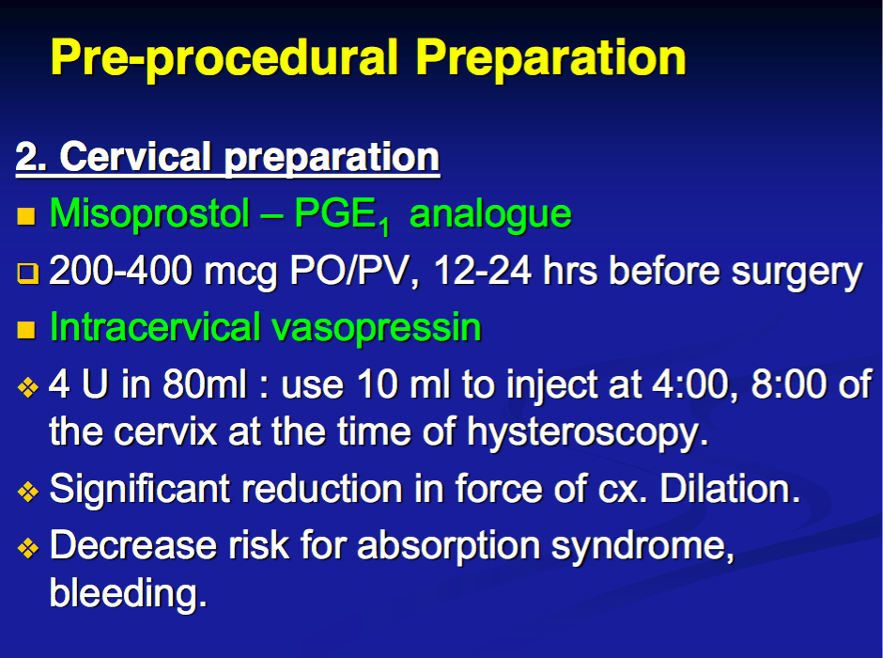

Slide 25
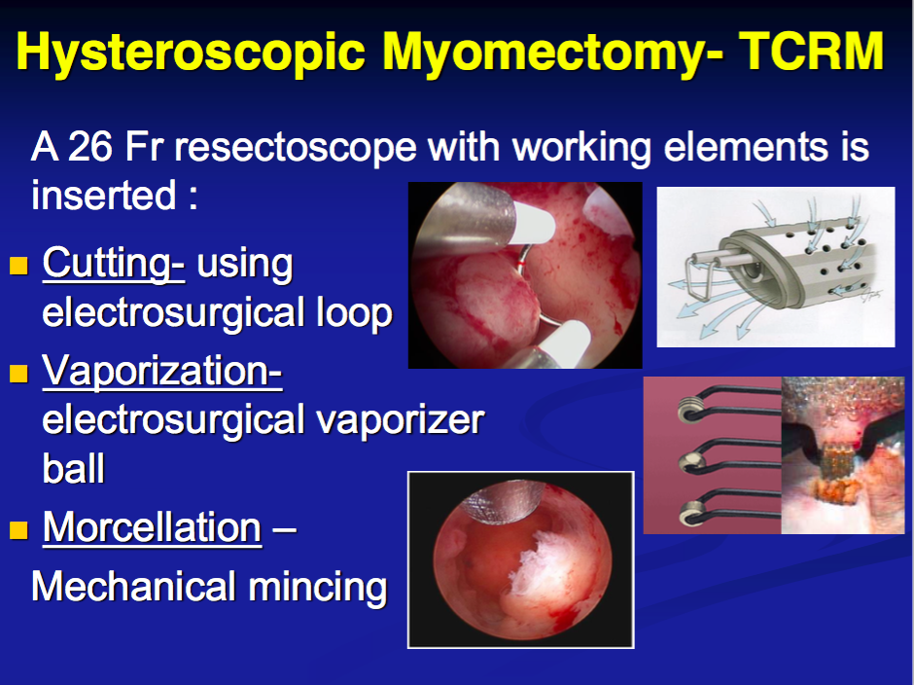

Slide 26
