Slide 1
Pap smear interpretation
By
Dr.N.Sundari

Slide 2
What is the role of pap smear in cervical cancer screening presently ??

Slide 3
Obsolete & historic importance ??
Gold standard test for cervical cancer screening
Eliminating cytology greatly simplifies screening – Cytology adds very little to the initial screen
ACOG Practice Bulletin Number 157, January 2016

Slide 4
VIA
Negative
Positive
Suspicious of malignancy
Rescreen every 3-5 yrs.
Eligible for cryo
treat with cryo
Not eligible for
Cryo. Treat with LEEP
Ref for appropriate diag & treatment
Post treatment follow up at 1yr.

Slide 5
Screen with HPV DNA
HPV test
Negative
Positive
Rescreen 5yrs
colposcopy
Colposcopy
positive
Colposcopy
negative
Suspicious of
cancer
Rescreen within 3yrs
Ref to appropriate diag & treatment
Biopsy
No biopsy
CIN II treat with cryo or LEEP
Eligible for cryo treat with cryo
Not eligible for cryo, treat with LEEP
CIN I or less rescreen with in 3 yrs.
Post treatment follow up after one year.

Slide 6
HPV & VIA screening
HPV test
Negative
Positive
Rescreen after 5yrs.
VIA
Negative
Positive
Suspicious of malignancy
Rescan after
1 yr.
Eligible for cryo
treat with cryo
Not eligible for
Cryo. Treat with LEEP
Ref for proper diag & treatment
Post treatment follow up at 1yr.

Slide 7
45 yr. old lady gets executive check up every year. The package includes pap smear. She has been getting every year pap smear for the last 5yrs.
Your comment on this?

Slide 8
How often we need to do pap smear?

Slide 9
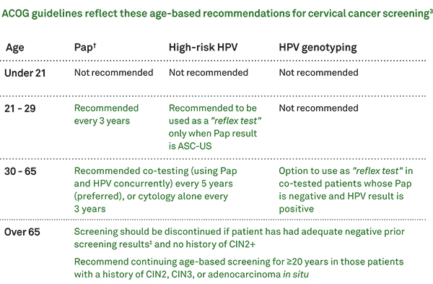

Slide 10
When is the best time to do pap smear?
Any prerequisites?
Contraindications.

Slide 11
Pap smear
Best time to do smear:
Mid cycle 8-12th day.
Not have sexual intercourse or put anything into your vagina for 24 hours before pap smear.
(douches, tampons, and vaginal medicines).
Contraindications:
evidence of acute infections.
Presence of bleeding.

Slide 12
How to perform pap smear?

Slide 13
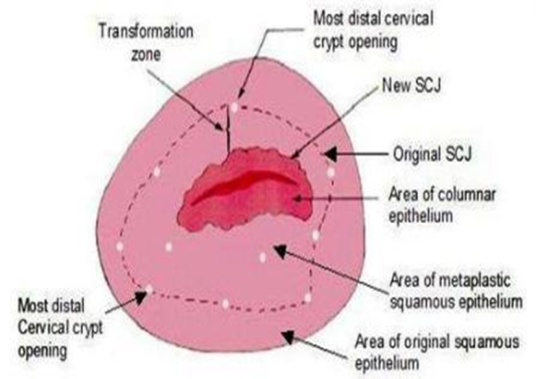
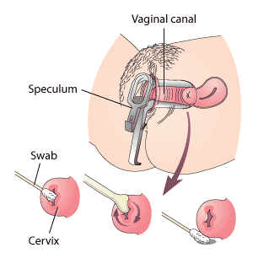
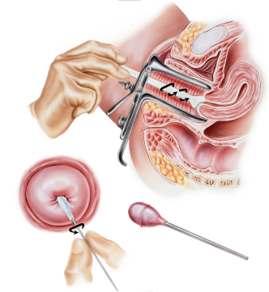
Procedure
Consent and explain the procedure.
Brief history: Hormone therapy.
Previous abnormal smear or treatment.(cryo or LEEP)
Proper positioning of the patient.
Good visualization of the cervix
No chemicals to clean the vagina.
Lubricants can be used with caution and care.
Excess mucus to be removed from cervix
Ecto cervical cells to be scarped-Turn spatula 360 degrees.
Endo brush to be used .
Rotate in single direction.

Slide 14
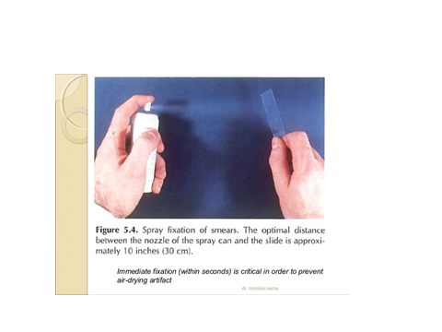
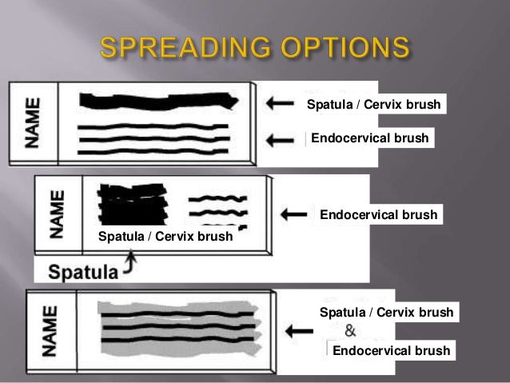
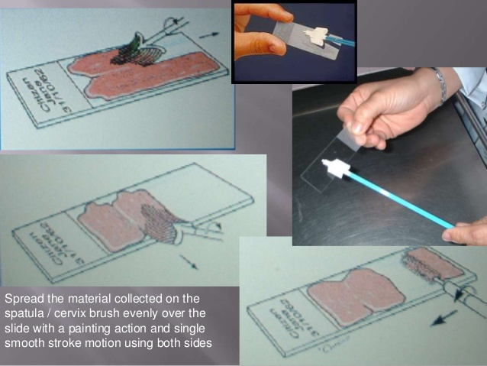
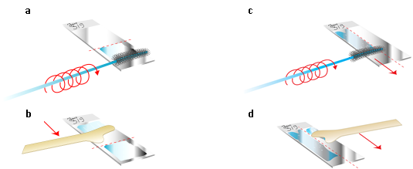
Spreading the smear and fixing the smear

Slide 15
What are the limitations of pap smear?

Slide 16
How to improve?
High false negativity -15-50%
False positivity.5-10%

Slide 17
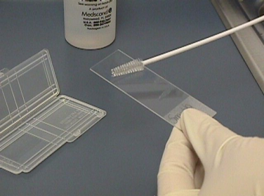
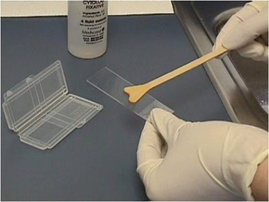
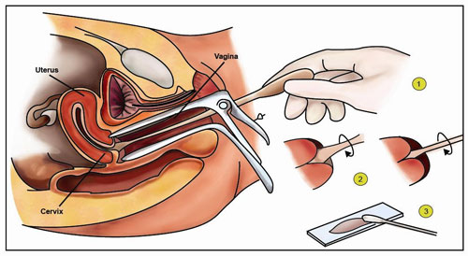

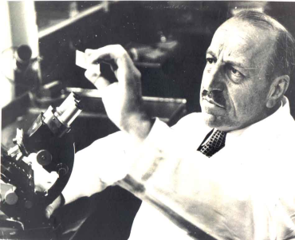
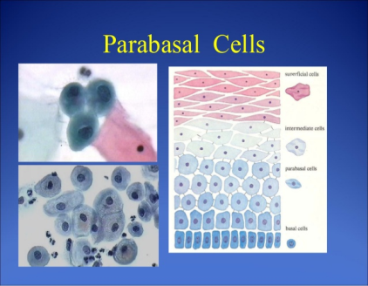
High false negativity is due to many correctable simple problems.
Specimen fixing error
Sampling error
Cause for the limitations?
Screening error by cytologist
Interpretation error
Various limiting factors:
Infection
Bloody smear.
Lot of mucus on the smear.

Slide 18

Sensitivity of the pap smear can be improved.
Training to perform pap smear
Repeat the smear
Solution to the problem??
Auto pap
Liquid based cytology
Experienced cytologists

Slide 19
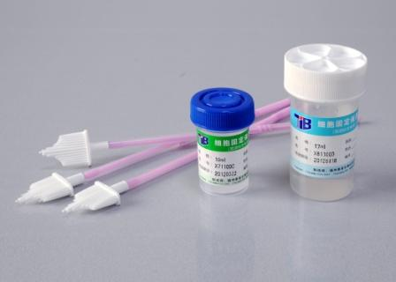
Liquid based cytology is cytology through liquid medium.
Cells collected from cervix are transferred to a liquid preservative instead on to a slide.
Improves the adequacy & quality of the smear.
Multiple slides can be prepared for detailed evaluation
Reduces cellular debris & RBCs. Cells are better preserved
Same sample can be used for HPV DNA assessment.
Infectious organisms better preserved
Liquid based cytology
Facilitates computer assisted screening
(automated cytology)
Reduces the false positive rate.
Improves the sensitivity and detection rate of low grade lesions.

Slide 20
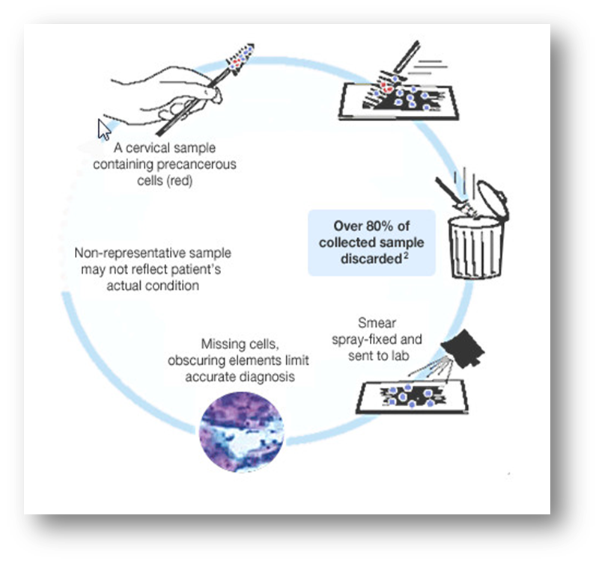
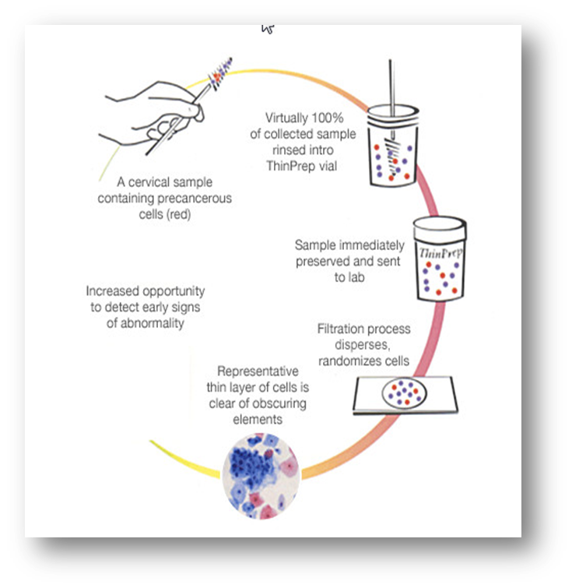

Liquid based cytology over comes the limitations of conventional cytology
Conventional smear cells needed
8000-12000
LBC cells needed: 5000.

Slide 21
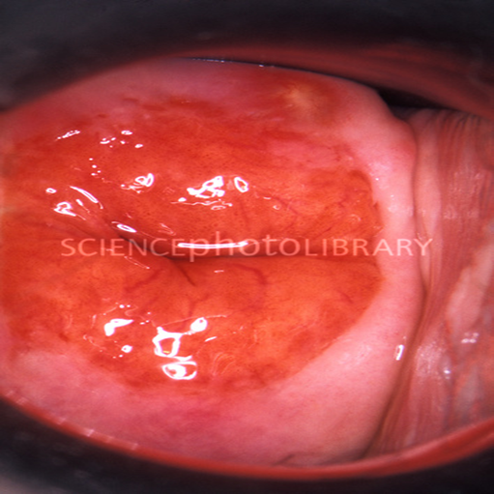
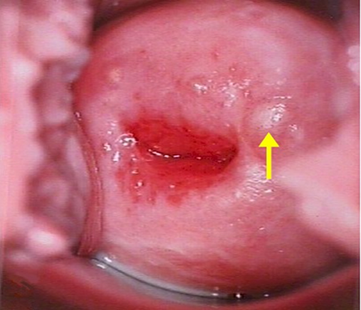
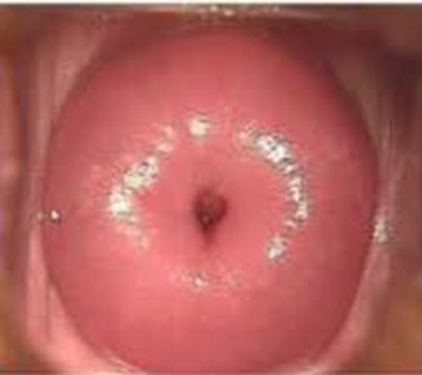
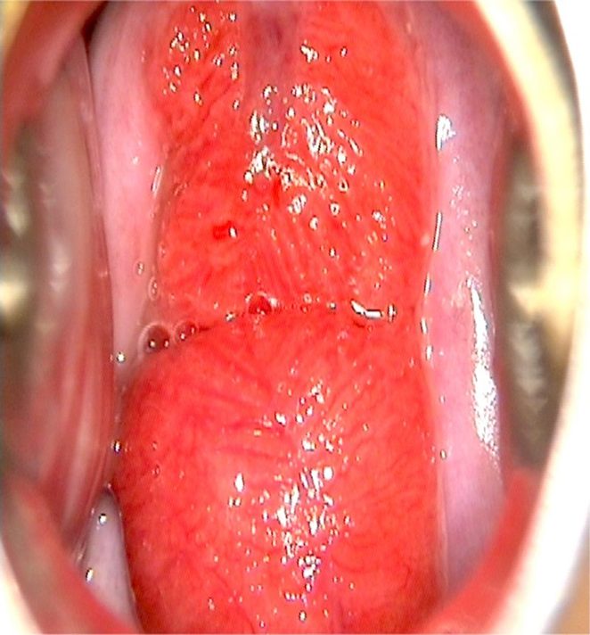
How do you take smear?

Slide 22
How should the slides be sent to the lab?

Slide 23
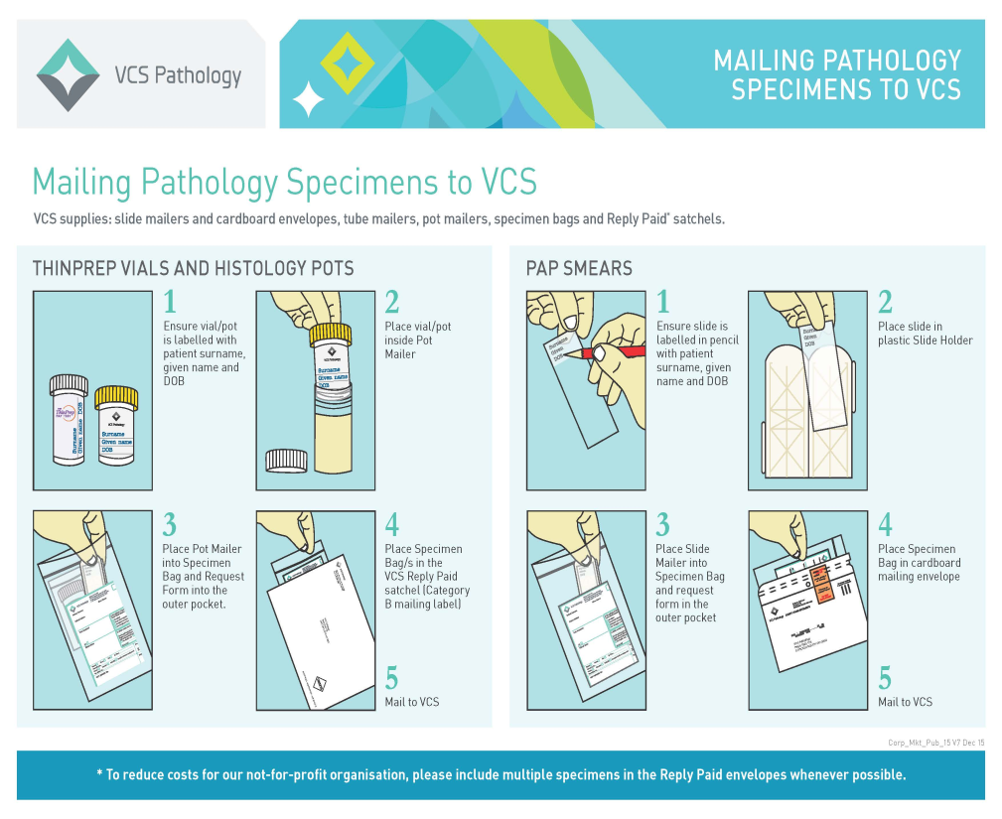
Proper fixation.
Proper labeling of the slide.
Brief clinical history to be given.

Slide 24
Interpretation of the pap smear reports and management

Slide 25
Pap report
Age:30yrs.
A few superficial and intermediate cells are seen. Plenty of RBCs and mucus seen in the smear. No endo cervical cells seen in the smear studied.
Interpretation?

Slide 26
Inadequate smear.
The cells from the cervix could not be seen clearly because of blood, inflammation or mucous
There are not enough cells for the proper interpretation.
Poorly prepared slide.
Broken slide.
Repeat the smear 6-12 months.

Slide 27
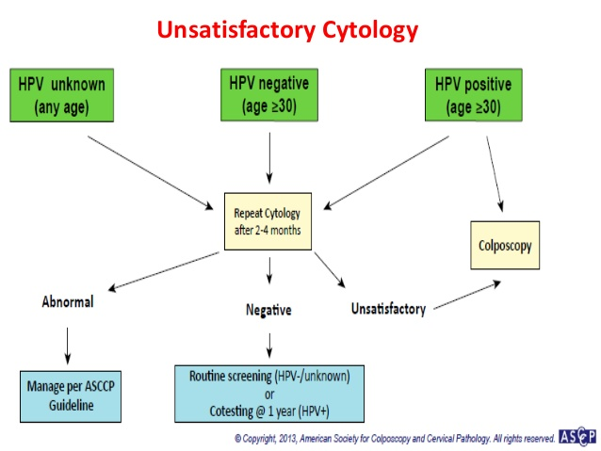

Slide 28
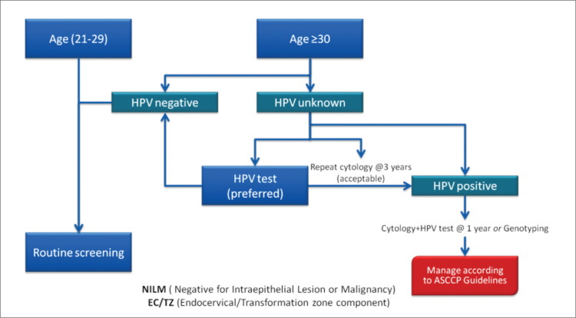
Management of cytology reported as negative but with absent or insufficient endo cervical and transformation zone

Slide 29
What is adequate smear?

Slide 30
Adequate smear(European guidelines)
Adequate smear should cover at least 10% of the slide (Sheffield et al. 2003).
Appropriate labeling and identifying information to be given.
A request form with all the relevant clinical information should be sent.
An “adequate number” of well preserved, well visualized squamous epithelial cells(8000-12000cells;LCB 5000cells )
“Adequate representation” of the transformation zone (TZ: endocervical cells or squamous metaplastic cells)

Slide 31
Pap report
Age:30yrs
Smear: adequate.
Description: Smear shows superficial intermediate and a few parabasal cells. Back ground shows plenty of neutrophils.
Impression: Inflammatory smear.
How do you manage?

Slide 32
Rule out infection.
Repeat pap in 6- 12 months.
If Inflammation is severe , interferes with ability of cytologist to accurately read the pap.
Persistent inflammatory smear- colposcopy is done.
10-13% may have underlying neoplasia.

Slide 33
Pap report
Age 30yrs.
Smear : adequate.
Mostly superficial and intermediate cells are seen. Back ground shows neutrophils and mucus along with Clue cells are seen.

Slide 34
Clue cells indicate Bacterial vaginosis.
Patient need to be treated for BV.
What other infections can be made out by pap smear?

Slide 35
Other infections can be made out by pap test are:
trichomoniasis infection.
HPV infection
Candida infection: need not treat unless patient is symptomatic.
Infections which are not diagnosed by pap smear are

Slide 36
Gonococcal infection
Chlamydial infection.

Slide 37
Pap report
AGE :35 Yrs.
Smear :adequate.
Description: mostly superficial and intermediate cells. A few metaplastic cells are seen in the smear.
Comment on the smear report.

Slide 38
Metaplastic cells indicate sampling from TZ.
No further evaluation needed.
No need to advise colposcopy.

Slide 39
Pap report
Age:35 yrs.
Smear : adequate.
Pap smear reads : superficial and intermediate cells are seen A few atypical cells are seen in the smear studied.
Comment?

Slide 40
Reporting should be in a standard reporting system(Bethesda system).
Grading of abnormality is essential.
A typia = AS-CUS

Slide 41
Pap report
Age:40yrs
Smear: adequate
Description: superficial and intermediate cells with a few Para basal cells are seen. A few abnormal cells are seen.
Impression: AS-CUS.
What is the next step?

Slide 42
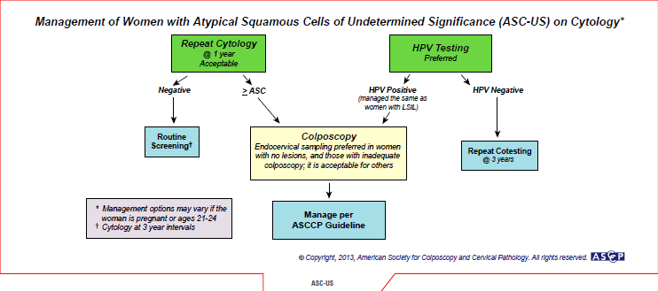

Slide 43
Cervical cancer risk scoring
How old are you?
How old were you when you first had sexual intercourse? 17 or younger 18 or older
Have you had sexual intercourse with more than one partner?
When was your last Pap test? Within the last 2 years, more than 2 years ago or never had a Pap test.
Do you have a family history (mother or sisters) of cervical cancer or cervical dysplasia?
Have you ever been diagnosed with: Genital warts (also called condyloma acuminata, caused by certain strains of HPV, or human papillomavirus) AIDS or HIV (human immunodeficiency virus) Chlamydia
Do you smoke?
Do you eat two or more cups of fruits and vegetables on most days?

Slide 44
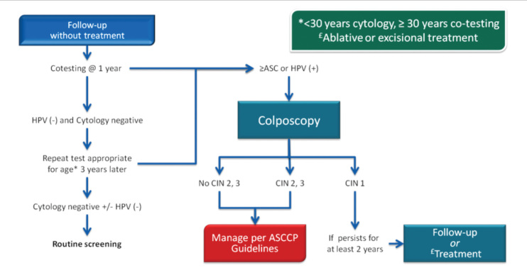
CIN 1 (with ASC-US or LGSIL cytology, HPV16/18(+) or persistent HPV) management

Slide 45
Pap report
Age:42yrs.
Smear : adequate
Description: predominantly seen are superficial and intermediate cells. A few cells show nucleomegaly with abnormal chromatin pattern. Nuclear cytoplasmic ratio is altered.
Impression: LSIL
What next?

Slide 46
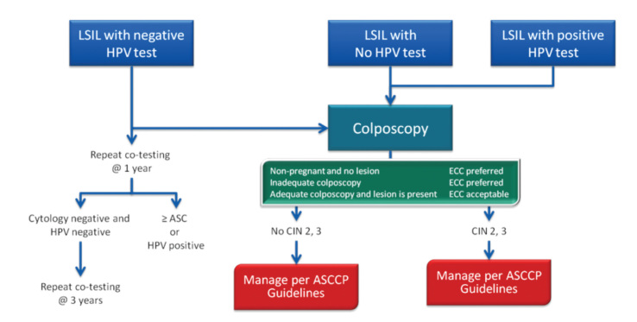
LSIL management

Slide 47
Pap report
Age 45yrs.
Smear: adequate
Description: Superficial intermediate and a few parabasal cells are seen A few cells show pyknotic and hyper chromatic nuclei with dense cytoplasm. Nuclear cytoplasmic ratio altered.
Impression: HSIL
What next?

Slide 48
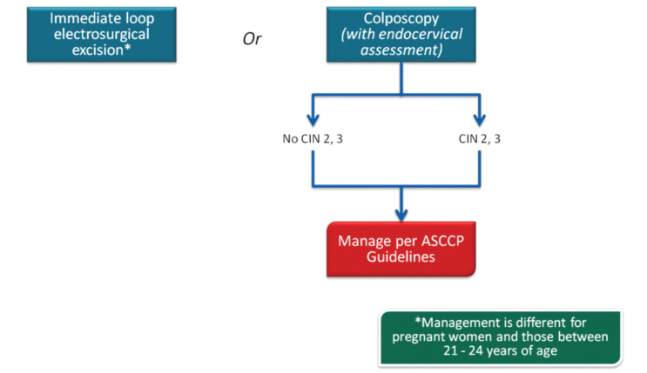
HSIL management

Slide 49
Pap report
Age:40yrs.
Smear: adequate
Description: Smear shows a few abnormal glandular cells.
Impression: AGC

Slide 50
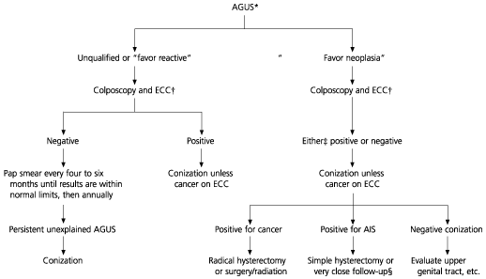
AGC management

Slide 51
Pap report
Age:46yrs.
Smear: adequate
Description: Smear shows superficial, intermediate and para basal cells and a few normal endometrial cells.
Impression: normal smear with endometrial cells.
Significance of endometrial cells in pap smear?

Slide 52
Endometrial cells in pap smear
More common when doing liquid based testing.
More common if PAP is done in first half of menstrual cycle versus latter half menstrual cycle (With in 12th day)
If the patient is pre -menopausal, cells are benign, and no abnormal bleeding, nothing need to be done.
If post -menopausal need endometrial office biopsy.
Any woman > 40 with this finding who has abnormal bleeding or if high risk for endometrial CA, (tamoxifen, estrogen therapy, anovulation, obesity, personal history of ovarian breast colon cancer) needs endometrial assessment.

Slide 53
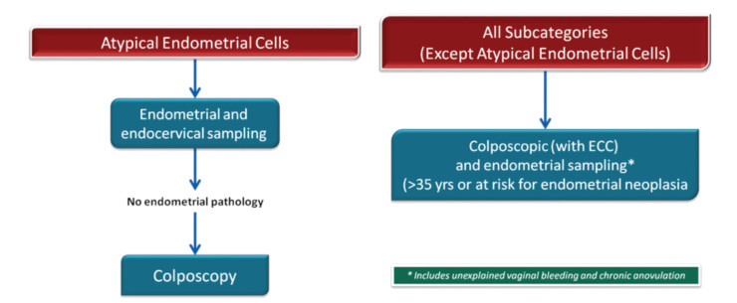
AGC management

Slide 54
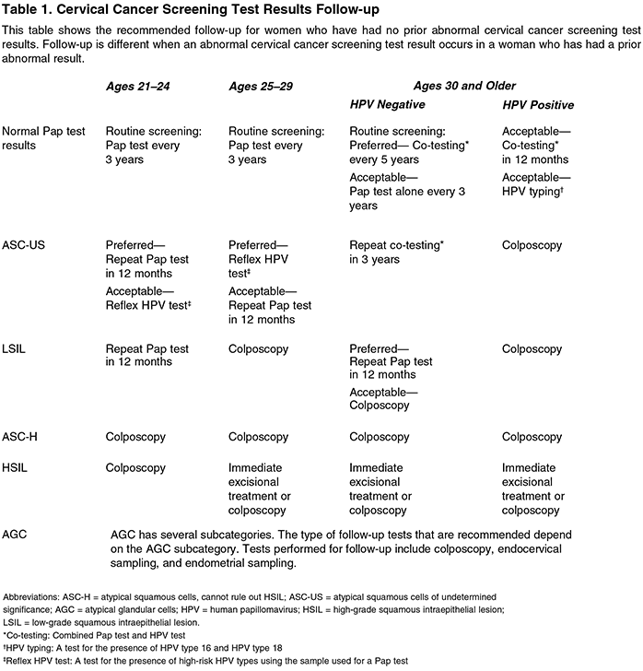

Slide 55
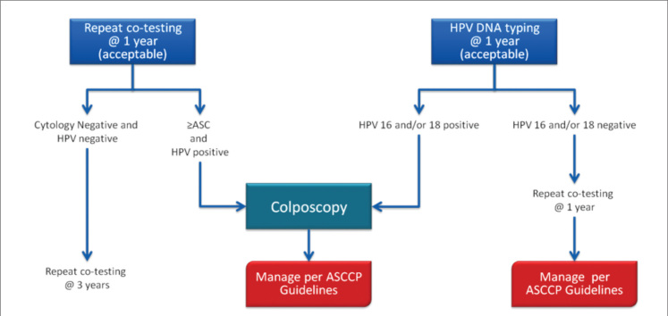
Management of HPV-positive cases with negative cytology

Slide 56
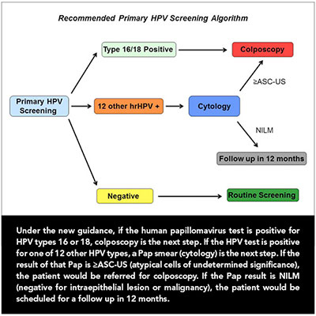
HPV DNA testing has been approved as a primary screening test by FDA on April-24-2014. but Clinical practice guidelines US have not yet incorporated it as primary screening method. APRIL 25, 2014 | BY CASEY GUEREN

Slide 57
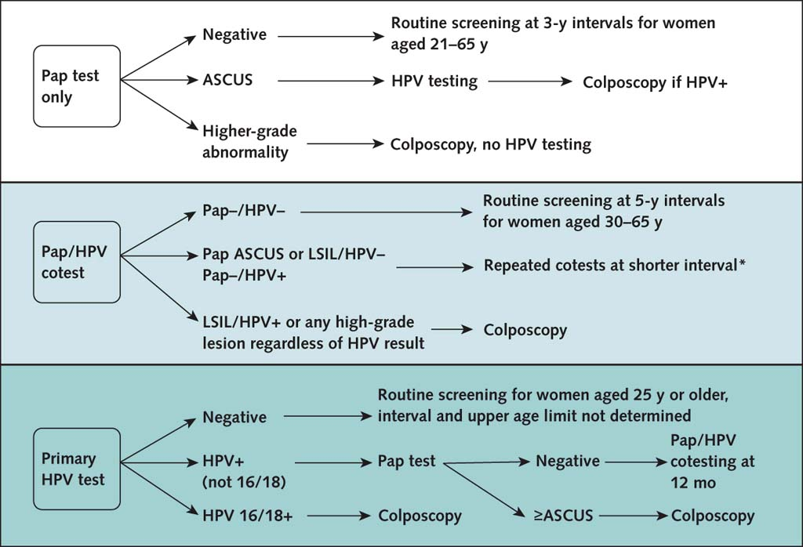
ACOG Practice Bulletin Number 157, January 2016

Slide 58
Conclusion
Pap test though loosing its popularity as gold standard test for cervical cancer screening, still is in use .
Proper sample collection, fixation and correct interpretation of the slide makes pap test worthy.

Slide 59

Thank you

Slide 60
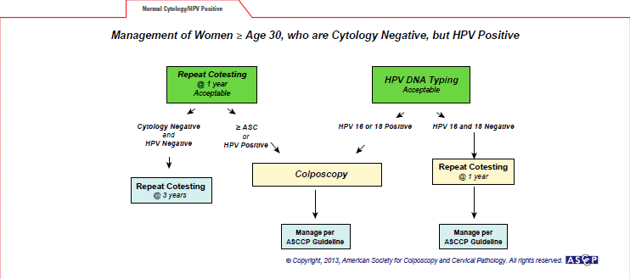

Slide 61
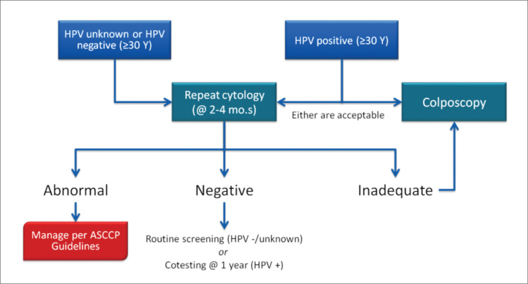
Management of unsatisfactory cytology

Slide 62
ACOG Practice Bulletin Number 157, January 2016
Negative Routine screening @3yrs interval
Ascus HPV testing colposcopy if HPV + tive High grade Colposcopy : no HPV testing
abnormality
Pap-/HPV- routine screening @5yrs interval -30-65yrs.
Pap AS CUS/LSIL/HPV- Repeat co testing at shorter intervals. pap-/HPV+ LSIL/HPV+, any high grade Colposcopy
lesion regardless of HPV results
Negative Routine screening from 25yrs of age .
HPV + Pap test negative co testing 12 months
(not 16 &18) > Ascus colposcopy
HPV 16 &18 positive colposcopy.
Pap test only
Pap &HPV co testing
Primary HPV DNA test

Slide 63
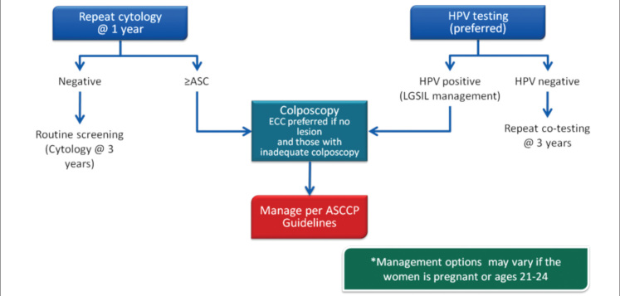
ASC-US management

