Slide 1

ObG Watch
April 2015
Contraception in Future

Slide 2
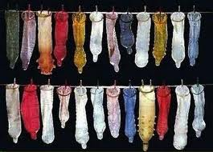
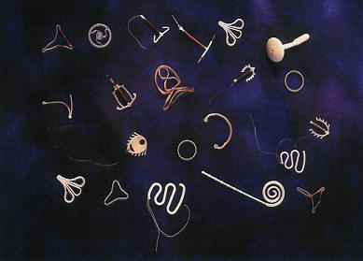
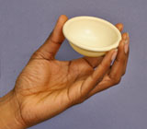
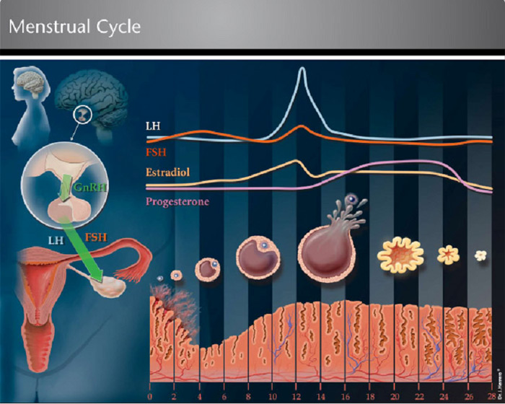
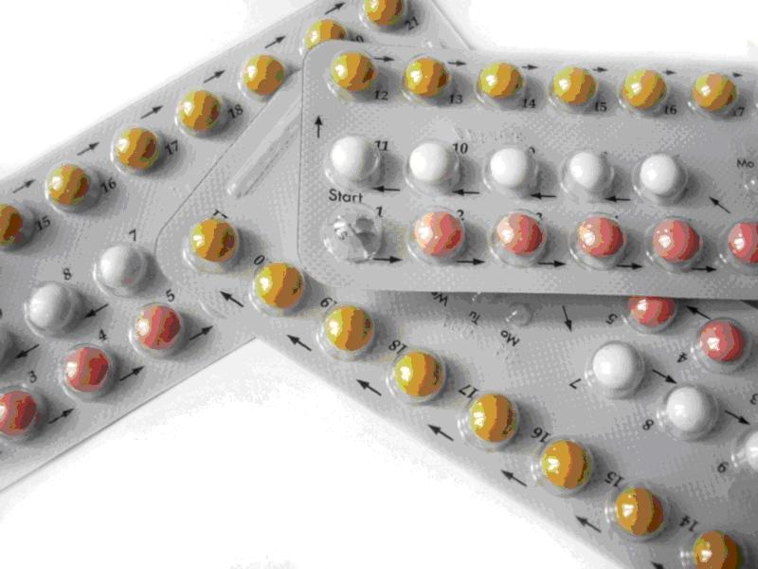
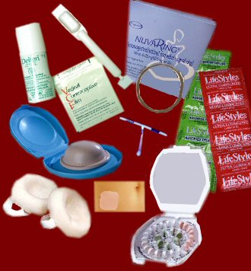
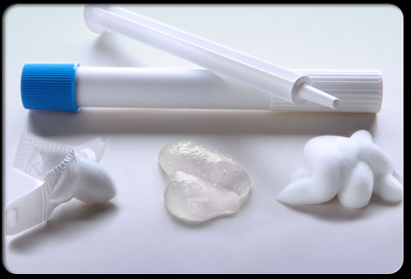
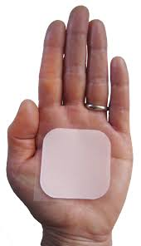
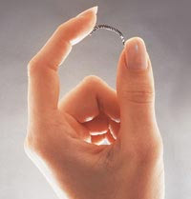

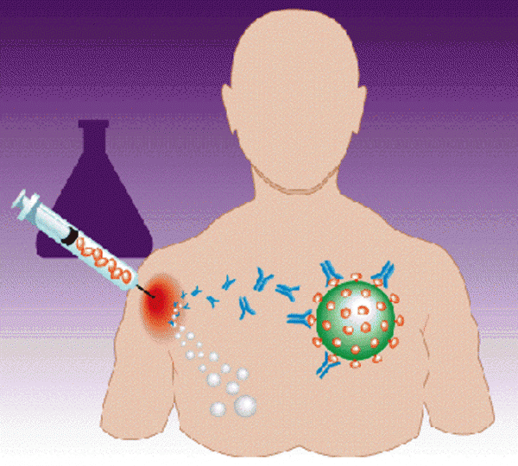
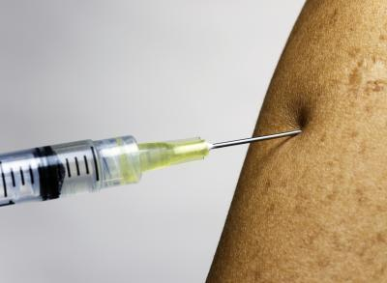
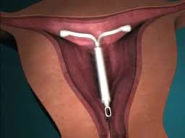
Notes:
For men, condoms & vasectomy

Slide 3


Slide 4
Condoms of the Future
“The goal is to make a condom that has the same texture as human skin – One will not even know it’s there”
Belinda & Bill Gates Foundation has issued $100,000 as grants to develop better designed condoms

Slide 5
“Ultra sensitive reconstituted bovine collagen” condom
“Polyurethane elastic polymers” (elastomers) that react to a change in temperature - Fits better
“Super-hydrophilic nanoparticle coating“- Reduces friction.
“Graphene” hundred times stronger than steel & only one atom thick - Enhances natural sensation
“Superelastomer technology" super-thin and super-soft, can be repeatedly stretched

Slide 6
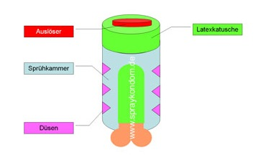
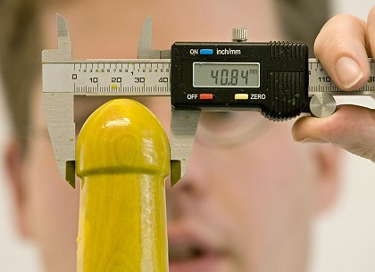
Spray on condoms
Jan Vinzenz Krause of the Institute for Condom Consultancy
Cartridge
Liquid Latex
cartridge
Sprays uniform layer of Latex
Sprayers

Slide 7
Strategies for Male
Decrease sperm production
Decrease sperm motility
Delay maturation
Acidify semen
Make sperm non functional
Block retinoic acid (Block sperm production)
Diasble Ca ion channels in tails (Impede movement)
Increase vaginal hostility
Synthetic testosterone
Androgen receptor modulation

Slide 8
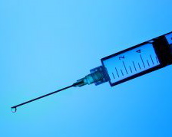
R.I.S.U.G
Reversible Inhibition of Sperm Under Guidance
Developed at IIT Kharagpur by Dr. Guha
Currently undergoing Phase III clinical trials
RISUG works by injection into vas
The gel coats the walls of the vas
The differential charge from the gel ruptures the sperm’s cell membrane
as it passes through the vas, stopping
the sperm

Slide 9
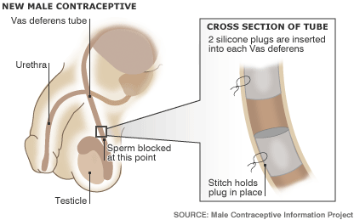
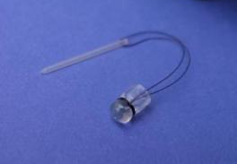
Intra Vas Device (IVD)
Silicone plugs (US)
Urethane tubes (China)
90% Azoospermia
Reversal rate similar to Vasectomy

Slide 10
Anti Fertility or the Contraceptive vaccines (CVs)
Potentially ideal contraceptive
Targets:
Production of GRH, FSH, LH
Gamete function (ZP)
Sperm antigen
Gamete outcome (hCG)

Slide 11
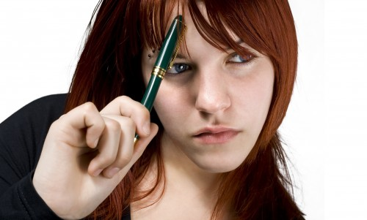

Slide 12
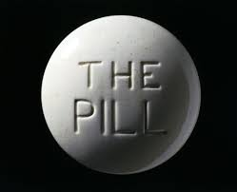
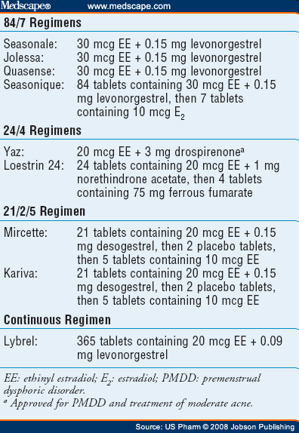
EXTENDED REGIMENS

Slide 13
Qlaira (E2V + DNG)
Estradiol valerate (E2V)
Dienogest (DNG)
Anti androgenic directly acting on SHBG
No estrogenic, glucocorticoid or mineralocorticoid activity
Unique estrogen (3 – 2 - 1mg) step down -progestogen step up (2 - 3mg) 26+2 day protocol) Estrogen dominance for endometrial proliferation followed by progestogen dominance for stromal stability (optimal cycle control)

Slide 14
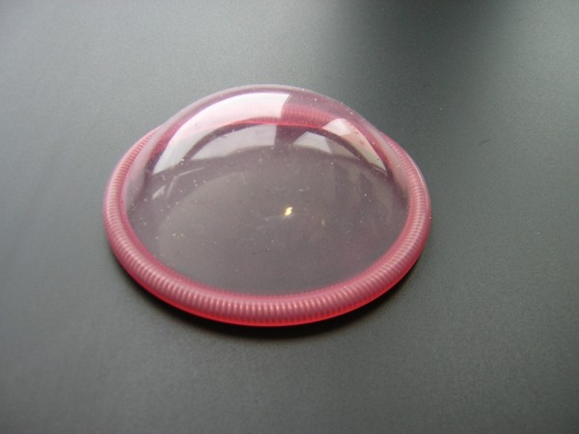
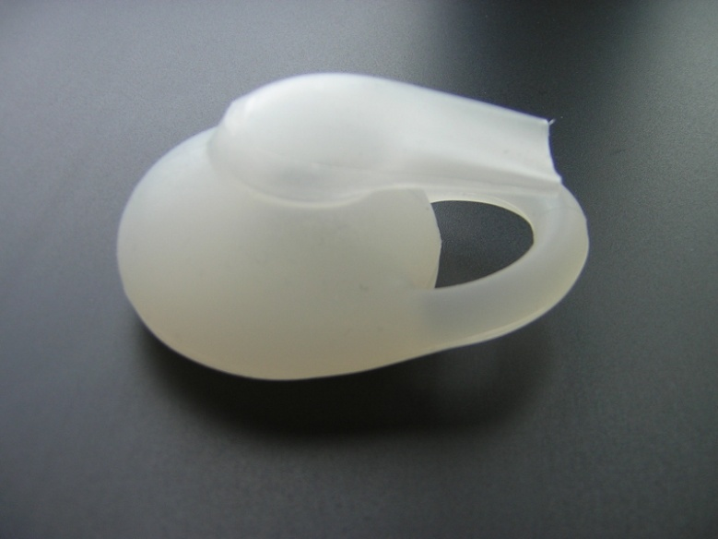
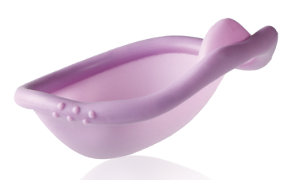
SILCS Diaphragm
Silicone barrier contraceptive device
Dome filled with Buffer Gel that acts both as a spermicide and microbicide
One size fits all
Improved acceptability & satisfaction
SILCS
FEMCAP
CAYA
Notes:
Kill sperms & germs

Slide 15
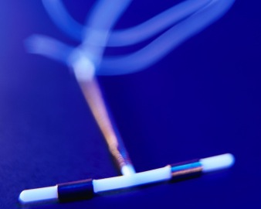
SKYLA
The new Hormonal IUD
Smaller, delivers lower dose of Progesterone & lasts for 3 years
Designed for teenagers & Nullipara

Slide 16
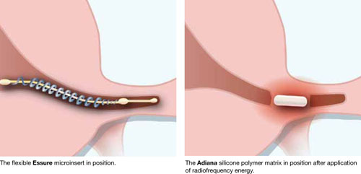
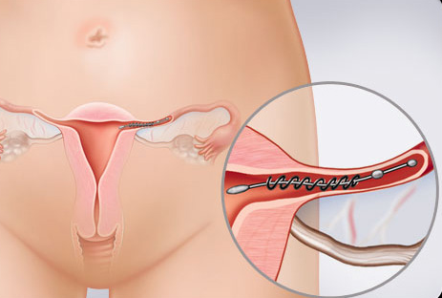
Essure
Hysteroscopy directed tubal occlusion
HSG after 3 months to confirm tubal block
Effective >99%

Slide 17
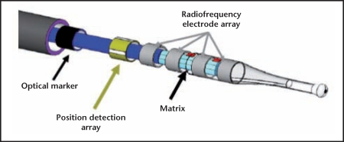
ADIANA System
Hysteroscopic Application of radio frequency energy followed by
Insertion of Silicone polymer matrix

Slide 18
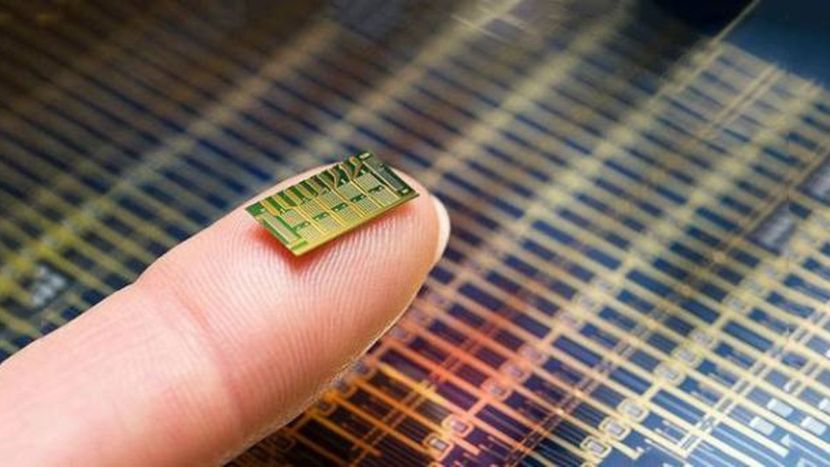
Drug-delivering Microchip
Notes:
Bill Gates- MIT’s Electronic answer to contraception-

Slide 19
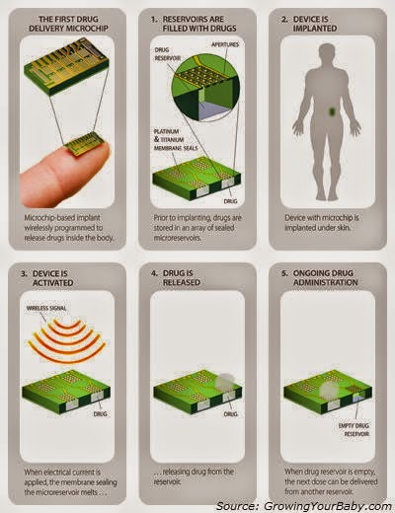

Slide 20
What happens when Contraception becomes super successful?
Notes:
Death rate exceeds birth rate

Slide 21
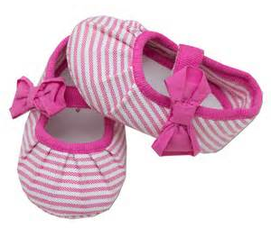

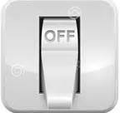
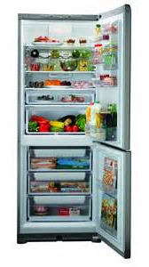

JAPAN
SOUTH KOREA
SINGAPORE
Incentives
to make
Babies
RUSSIA
FRANCE
Notes:
Make babies in a hurry-ambience & atmosphere-tax rebates, discounted train bus & even movie tickets-lottery prizes-baby hampers goodies

Slide 22
What happens when Dr Jayanthy’s initiative becomes successful?

Slide 23

Kamasutra in Delegate kits
Free BSOG Membership
Life time Achievement Award
Sponsored Study Tours
Notes:
Belur-Halebid

Slide 24


