Slide 1

ObG Watch
Narayanan R
September 2015

Slide 2
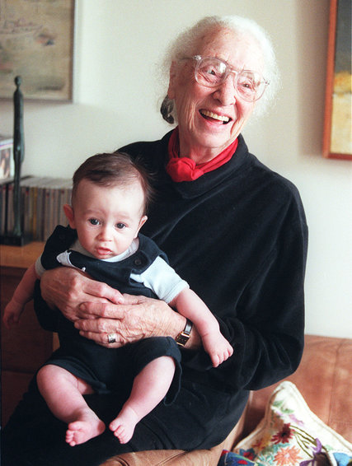

Elisabeth Bing, ‘Mother of Lamaze’ Dies at 100
Notes:
Elisabeth Bing, who helped lead a natural childbirth movement that revolutionized how babies were born in the United States, died on Friday at her home in Manhattan.

Slide 3
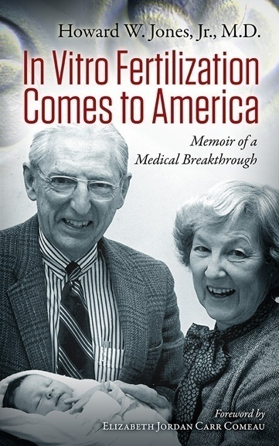
Howard Jones dies at 104
Responsible with wife Georgeanna Seegar Jones for the first IVF baby in US
Pioneered sex-change surgeries

Slide 4

The accompanying editorial commentary put the studies into perspective and supplied authoritative guidance

Slide 5
Role of Progesterone in RPL
Progesterone indispensable for progress of pregnancy
Deficiency of P in luteal phase (LPD) causes miscarriage (probably in >20% of all MC)
No current method to prove P deficiency
Hence P treatment is empirical at best
P has no place in natural unstimulated pregnancy unlike in ART assisted pregnancies
(2015 Committee Opinion by the American Society of Reproductive Medicine)
May be tried in RPL (>3) empirically after FH detected until 8-10 weeks of gestation. Evidence poor.
(Clin N Am, Mar 2015 Vol 42 No 1)
Oral or Vaginal? – Issue not resolved
Results of PROMISE Trial awaited

Slide 6
Non invasive Prenatal testing (NIPT)
Done around 10th week-uses cell-free DNA
Focuses primarily on the viable trisomies 13, 18, and 21. Detects Down syndrome in 99.2%
The test has low false positive rates
Contributed to >50% reduction in invasive procedures such as amniocentesis
Can throw up surprise results

Slide 7
NIPT can save lives
NIPT interrogates not only fetal DNA in maternal plasma but also cancer DNA
Can identify presymptomatic tumors
Among 4000 samples 3 had abnormal genome profiles
Whole body MRI revealed cancer in all 3 women
Vermeesch et al, June 5, JAMA Oncology 2015

Slide 8
One had high-grade serous cancer in both ovaries with diffuse peritoneal spread, multiple metastases, and lymph node involvement. She underwent successful treatment after delivery.
The second patient had follicular lymphoma and did not undergo treatment because of the slow-growing nature of this cancer.
The third patient had Hodgkin lymphoma. She received treatment during pregnancy and gave birth to a healthy girl.
Notes:
Importance of better consent-

Slide 9
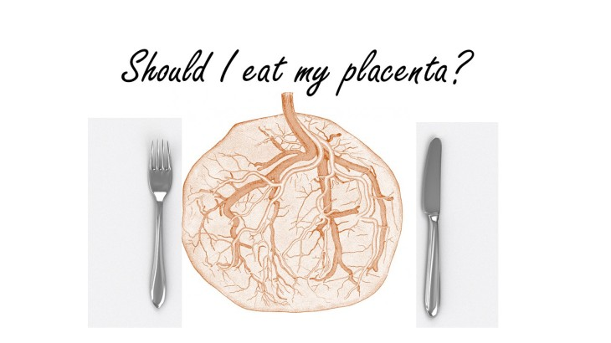

Slide 10
Benefits in Non human mothers
Increases interaction between mother and infant
Potentiates pregnancy-mediated analgesia in the mother
Stimulates maternal brain opioid circuits that facilitate the onset of caretaking behavior
Suppresses postpartum pseudopregnancy
(Ecology of Food and Nutrition Vol 51, Issue 3, 2012)

Slide 11
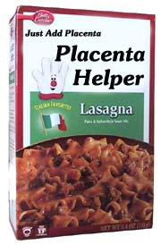
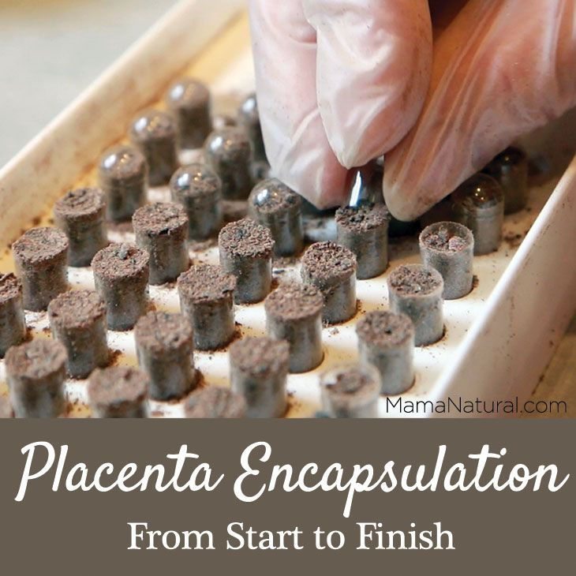
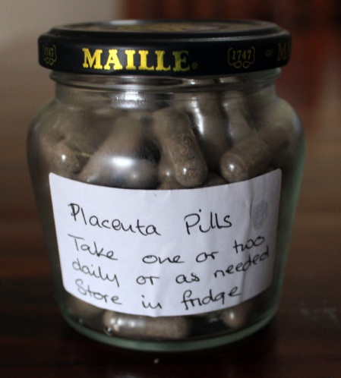
No proof but Speculation persists…
Is Placentophagia the answer to…
Postpartum depression
Failure to bond
Hostility toward infants

Slide 12

At last, a Pink viagra?

Slide 13

Sexual dysfunction affects 10% of women in US
They are chiefly, Hypoactive sexual desire disorder (HSDD) or Female sexual arousal disorder (FSAD) or both conditions
Bremelanotide (BMT or flibanserin), a novel heptapeptide melanocortin-receptor-4 agonist yields promise
Approved by USDA in August 2015
Clayton.A, American Society of Clinical Psychopharmacology (ASCP) 2015 Abstract presented June 23, 2015.

Slide 14
100 mg tab at bed time
Increases Satisfying Sexual Events (SSEs)
Improvement after 4 wks of daily treatment
SE: drowsiness/hypotension/syncope
Alcohol intake causes hypotension
Marketed as ADDYI

Slide 15
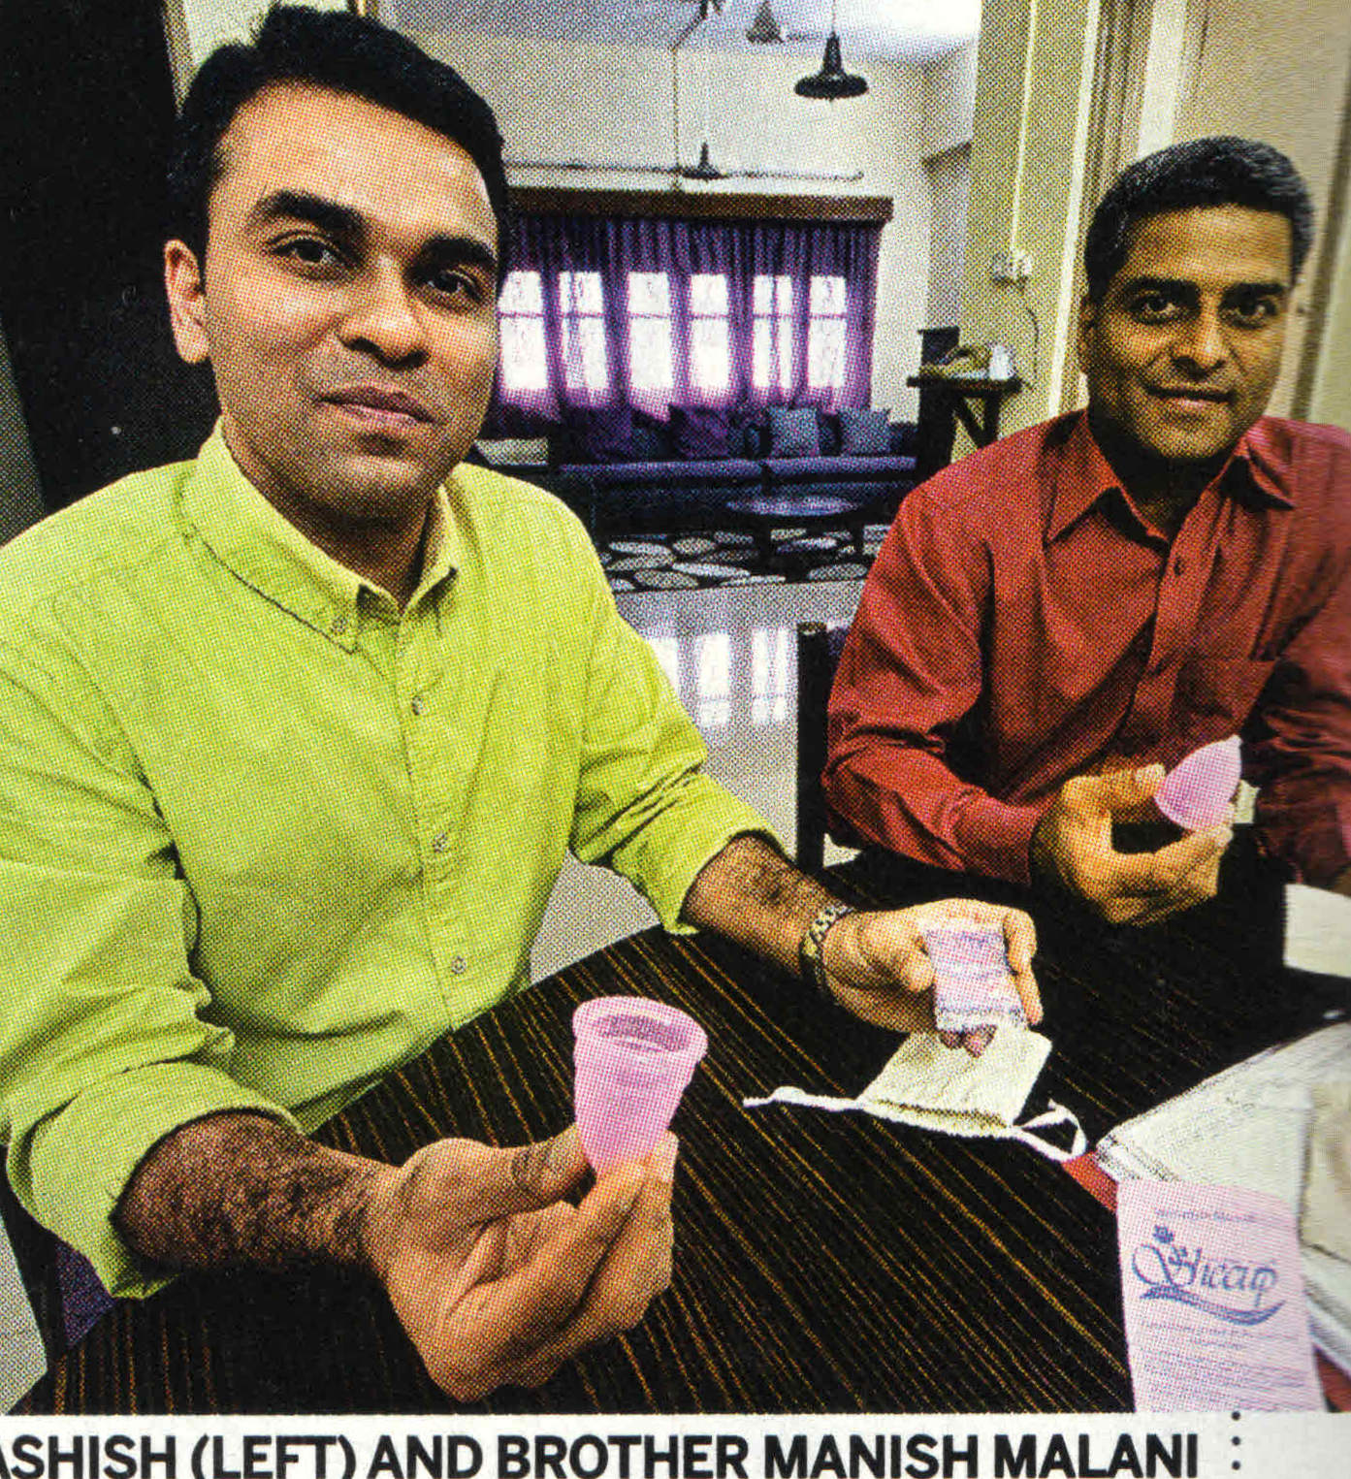
HE-MEN of SHE-CUP
Break throughs in small initiatives
Chartered accountant turned entrepreneurs manufacture
The first Indian brand of Reusable Menstrual cup
Cost Rs 675.00
India Today August 24, 2015

Slide 16
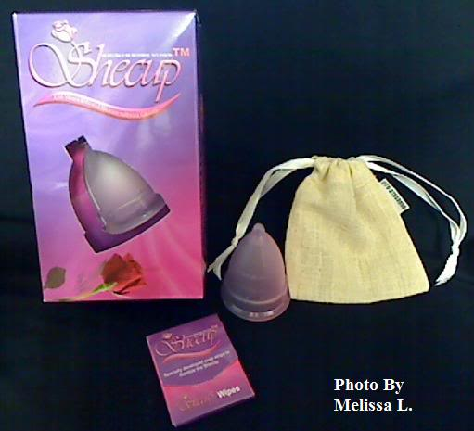
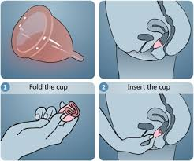
Made of high grade Silicon
Flexible
Can be kept for 12 hours
Rewashable
Reusable many years

Slide 17
Summer Babies
Children born in June, July and August face the so-called "birth-date effect“
They are statistically likely to perform less well than their older classmates
These sunshine-month youngsters never catch up with their older winterish peers
In a major overview, Cambridge concluded that summer babies were "strongly disadvantaged“
At the end of primary school the difference on average stands at 12%!
ObG Watch-July 2013

Slide 18
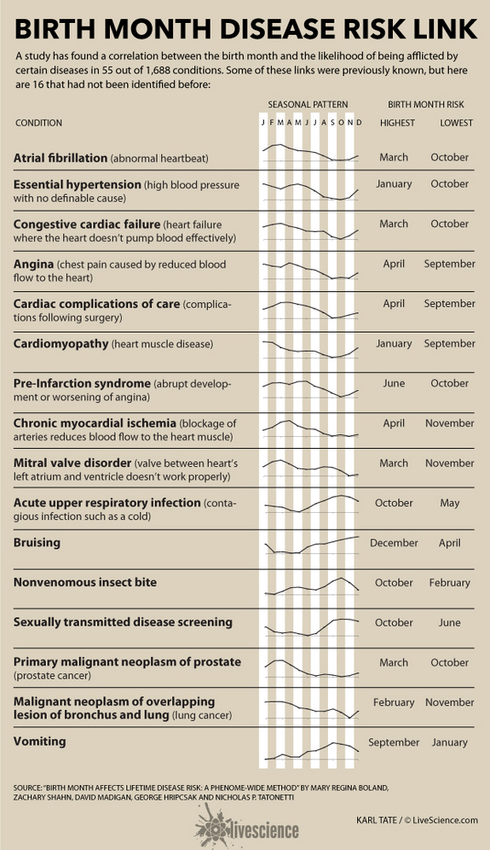
Notes:
May/July/August

Slide 20
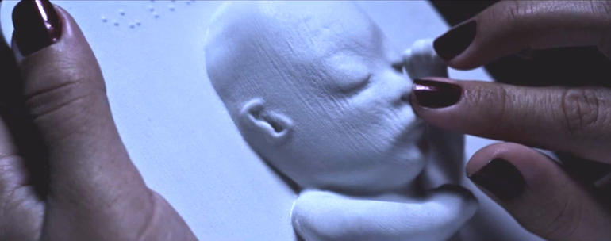
3D Printing

Slide 21


