Slide 1

ObG Watch
9th April 2017
Narayanan R

Slide 2
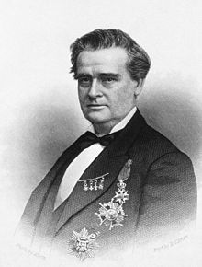
Notes:
Recognise?-Clue: Father-Instt used multiple in daily practice-

Slide 3
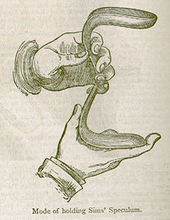
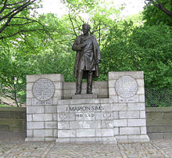
J Marion Sims

Slide 4
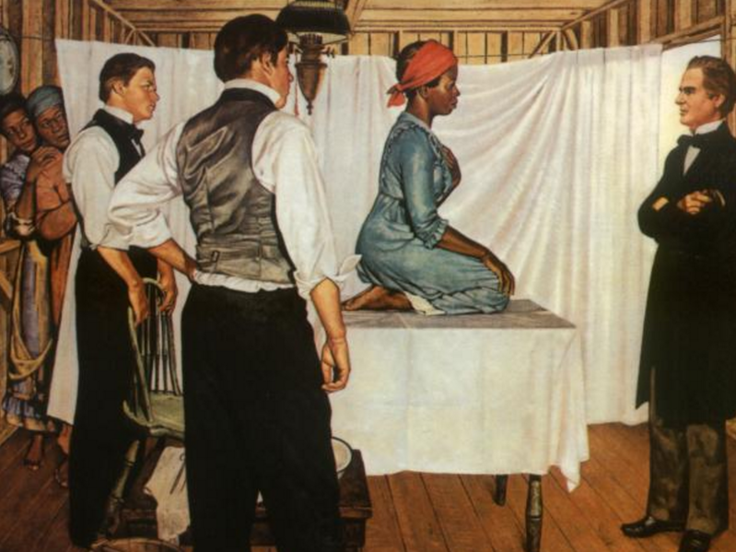
Notes:
Anarcha

Slide 5
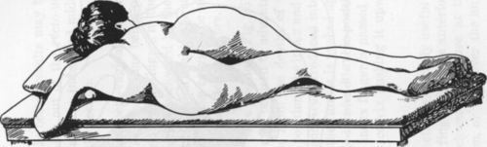
Position
Speculum
Silver sutures
Repair of VVF
Notes:
Commomorated-awarded- PresidentACOG-Statue empress & slaves-Laparotomy for gun shot wounds
Cholecystectom

Slide 6
Anarcha, Betsie and Lucie living research subjects
Modern gynecology traces its roots to these women
They were the true unsung heroes
They must be celebrated as Mothers of modern gynecology

Slide 7
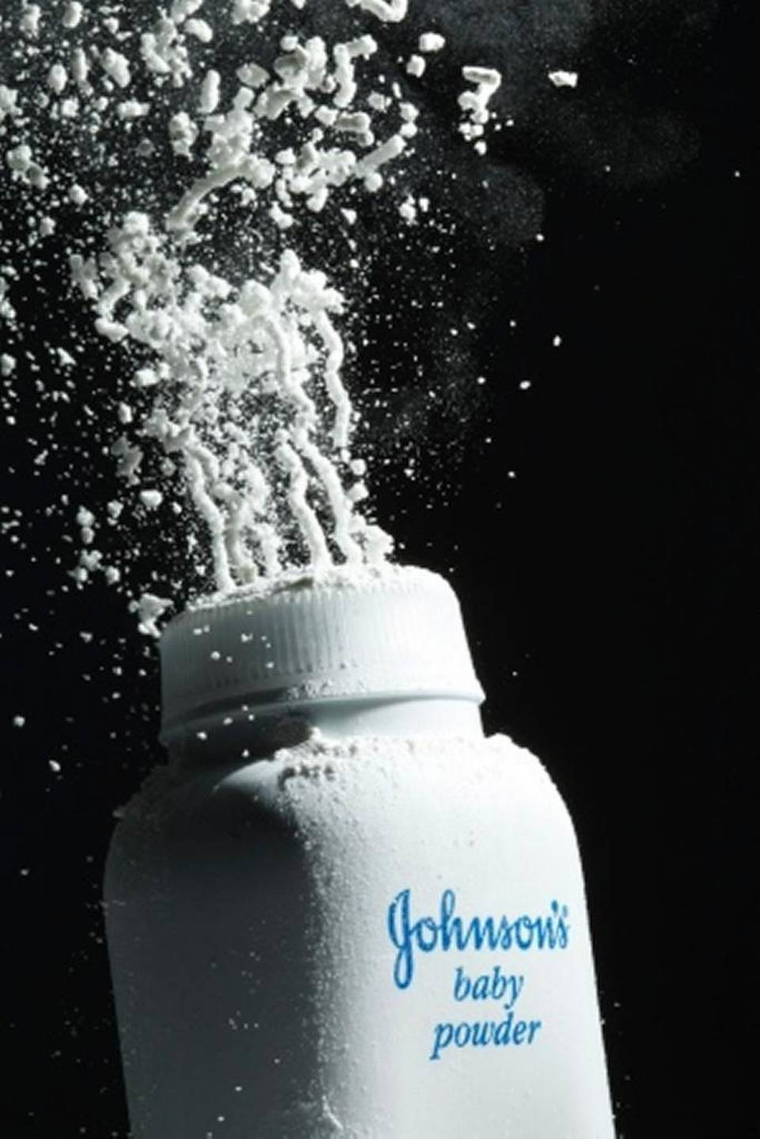
A jury in St. Louis, USA awarded $72 million to the family of a woman who died from ovarian cancer in October 2015
She claimed & convinced the jury that her cancer was caused by her regular use of Johnson & Johnson baby powder

Slide 8
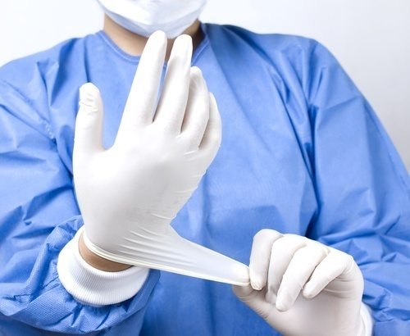
FDA bans powdered gloves
Powdered Surgeon’s Gloves, Powdered Patient Examination Gloves and Absorbable Powder for lubricating a Surgeon’s Glove are banned
From 18 January 2017

Slide 9
Dangers:
Allergy, Airway inflammation, wound inflammation, post op adhesions
Lycopodium powder was first found to cause granulomas & adhesions in 1930s
Replaced by talcum powder (Mg silicate}
Also a cause of granulomas & post op adhesions in 1940s
Replaced by Corn starch

Slide 10
Do you know
how many
(Official)
organs
we have
in our body?
Notes:
Today being Sunday..rest of the day to find out

Slide 11
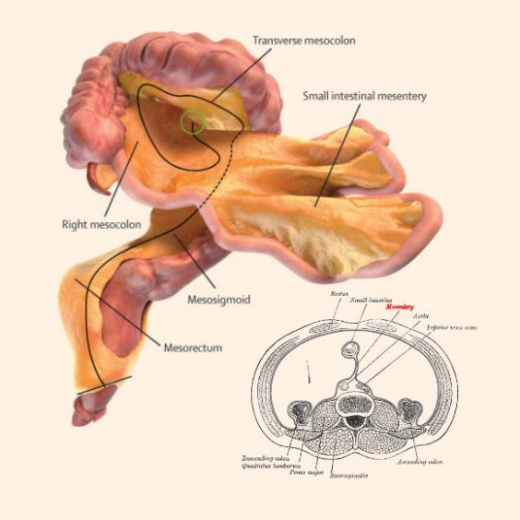
The 79th organ in Human body
discovered!
The discovery of Mesentery by Coffey & O’Leary as one organ opens up a new science
The MESENTERY was first described by Learnardo Da Vinci in 1508
Long thought to be a fragmented structure with no significant function
The anatomy & structure has been defined
The function & categorization of diseases are to be determined

Slide 12

Bilateral
Total
Salpingectomy
Permanent method of irreversible female contraception
Prevents Hydrosalpinx
Prevents Tubal ectopic pregnancy
Seldom performed as prophylaxis

Slide 13
In 75-80% of Ovarian Ca, primary origin is Fallopian tube -J Current Oncol - 2016
Gyn Oncol society, Canada (2016) recommends Bilateral total Salpingectomy at hysterectomy or sterilization to prevent Carcinoma Ovary
Case control study awaited

Slide 14
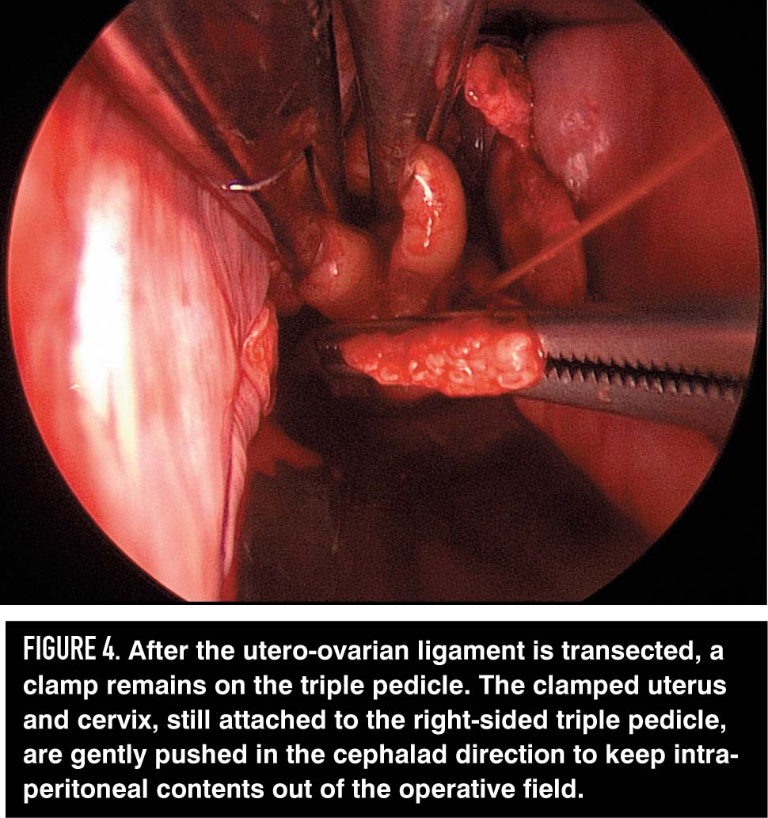

Slide 15
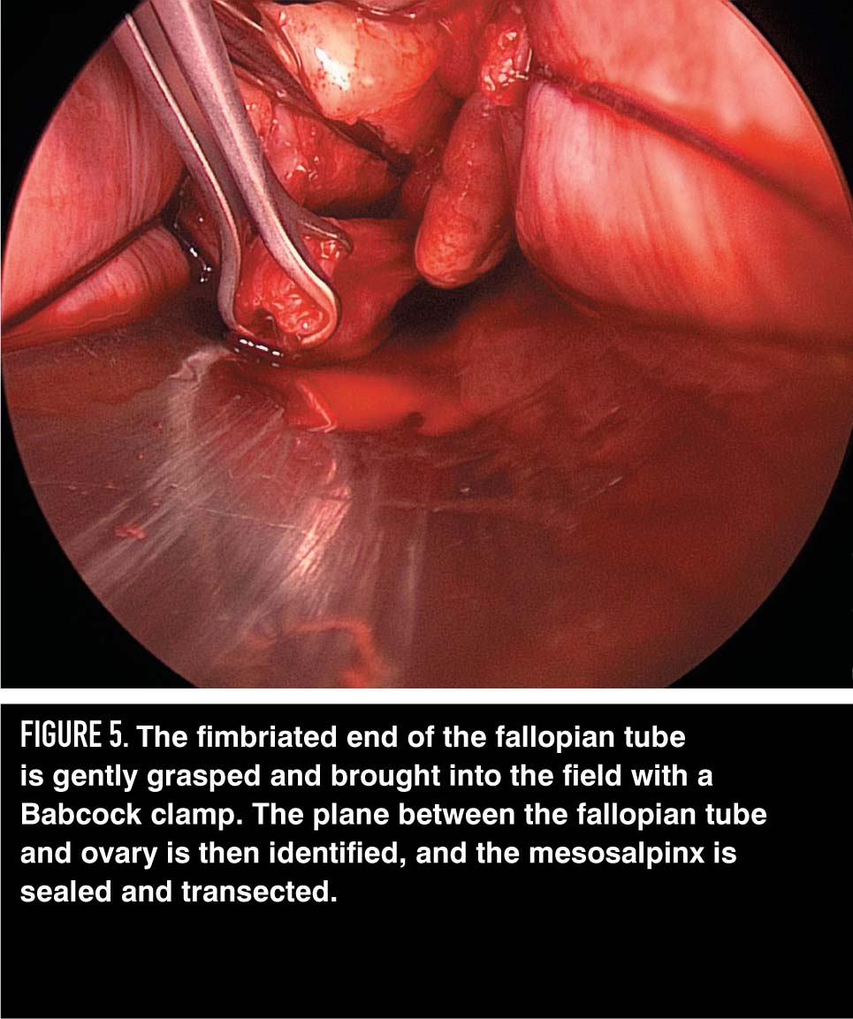
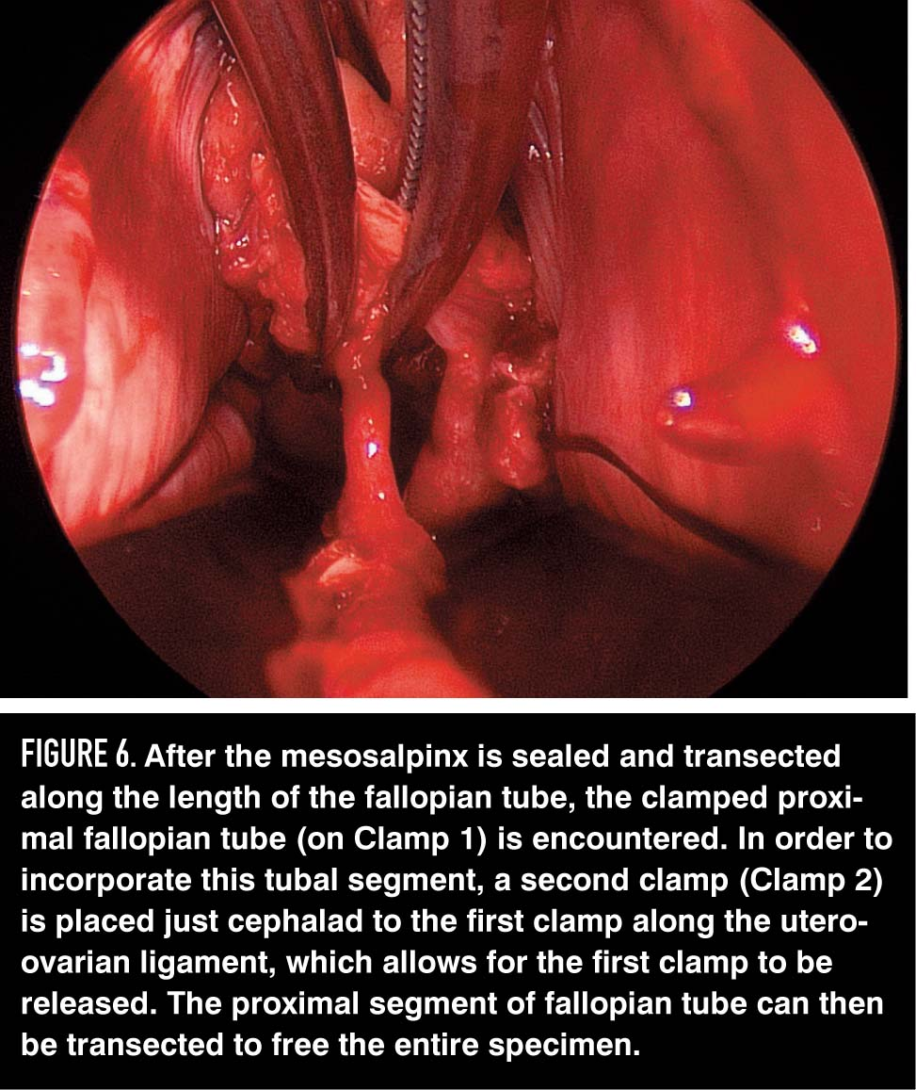

Slide 16
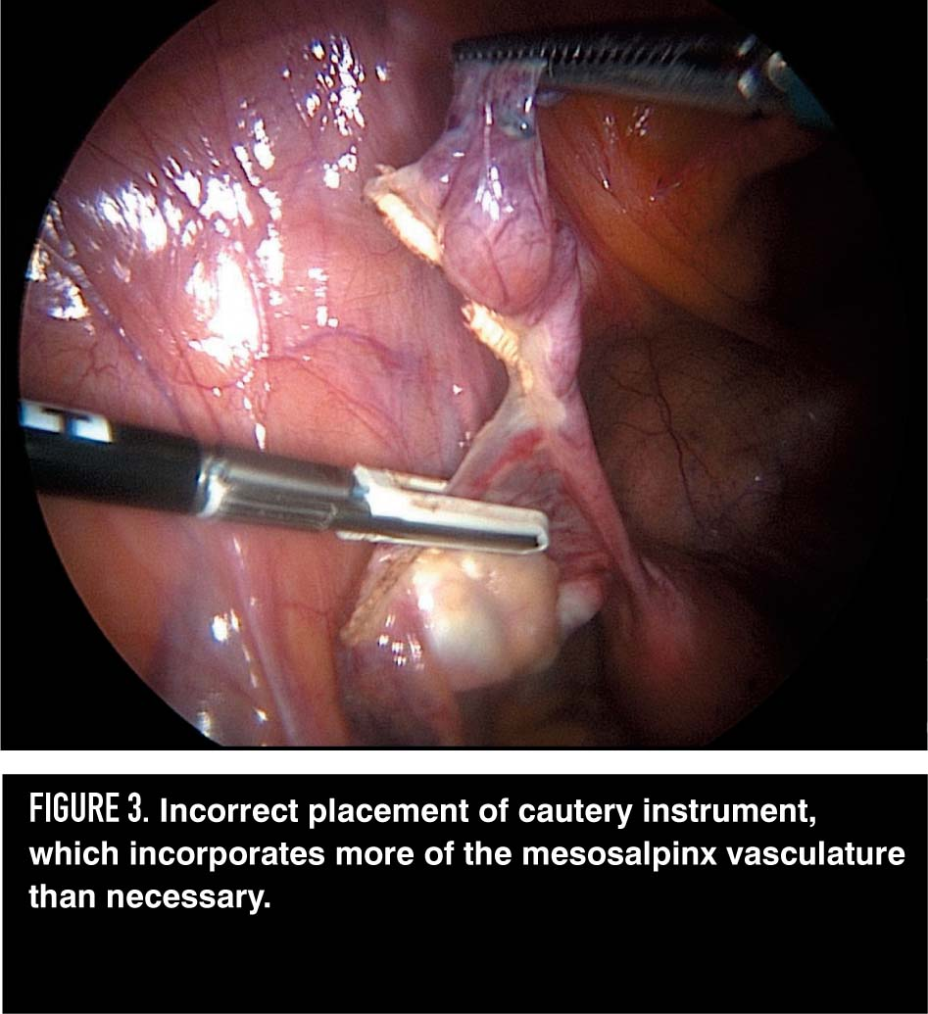
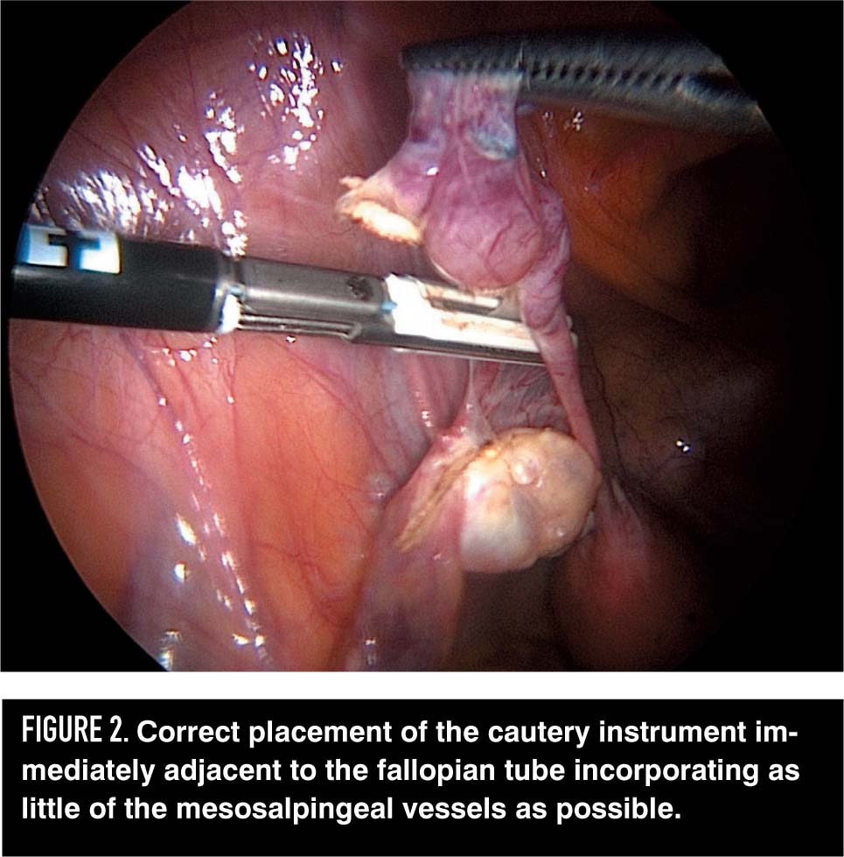

Slide 17
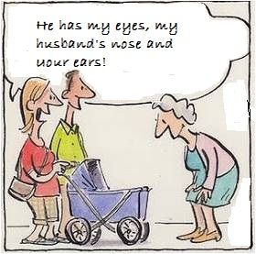

Slide 18
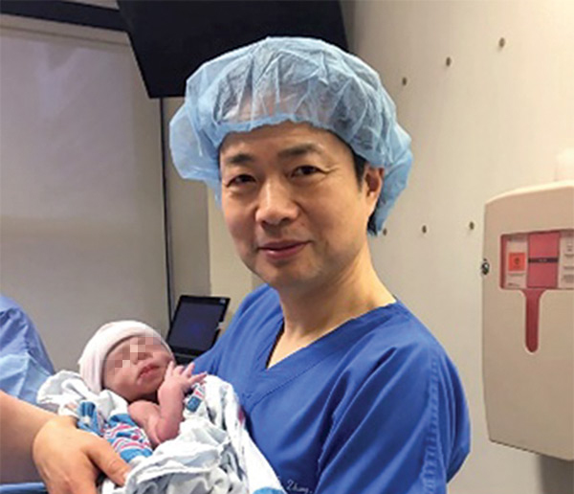
World’s first controversial procedure done by Dr Zhang in Mexico
Mother with h/o 4 miscarriages & 2 children succumbing to Leigh syndrome
Licenced in UK in March 2017
The 3-Parent Baby
Leigh's disease is a rare inherited neurometabolic disorder, caused by mutations in mitochondrial DNA or by deficiencies of an enzyme called pyruvate dehydrogenase. that affects the central nervous system, progresses rapidly & causes death.

Slide 19
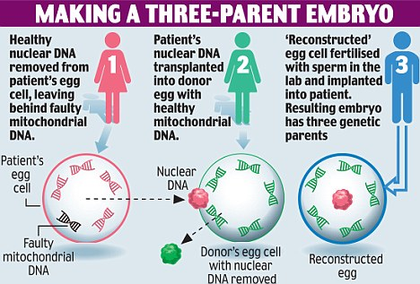
The Recipe

Slide 20
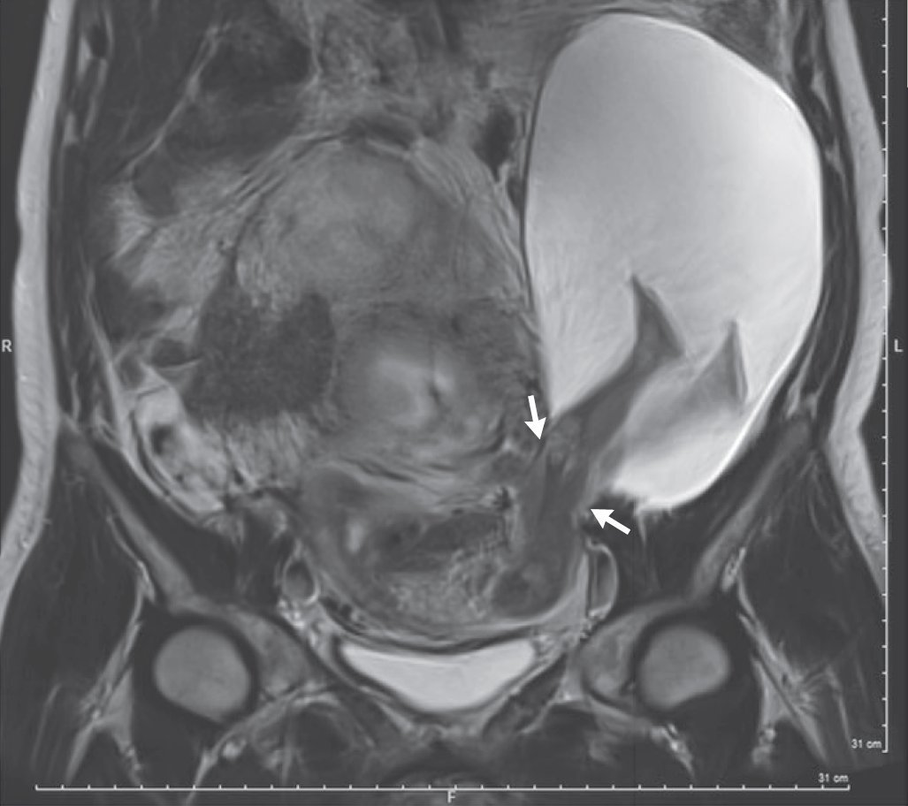
Incredible Image

Slide 21
Asymptomatic Gravida 6 – Para 5
H/o 5 Previous LSCS
Image taken at 22 weeks
Risks explained: ( Extension of rupture, PPROM, Preterm birth, Fetal death, emergency hysterectomy)
Couple wanted to continue the pregnancy
The tear increased to 5 cm at 30 weeks
The fetal abdomen and both legs prolapsed
Live male baby weighing 1.385 kg delivered by Emergency CS
Mother & baby doing well
Dr Pierre-Emmanuel Bouet, Angers University Hospital, Fance
Notes:
26 cases reported in world literature

Slide 22
Thank you!

