Slide 1

ObG Watch
16th October 2016
Narayanan R

Slide 2
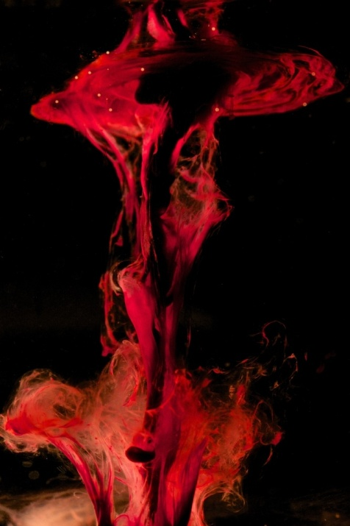
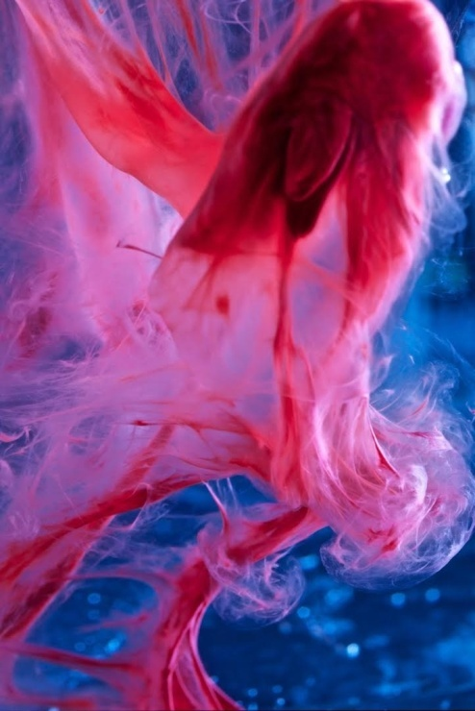
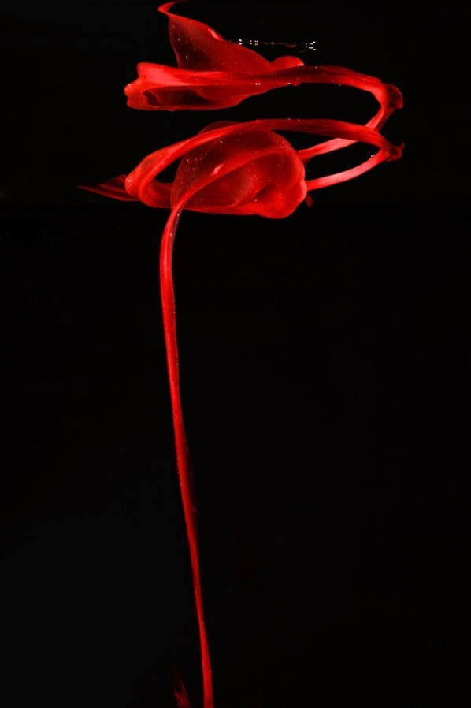
“Beauty in Blood”
Robert Lewis

Slide 3
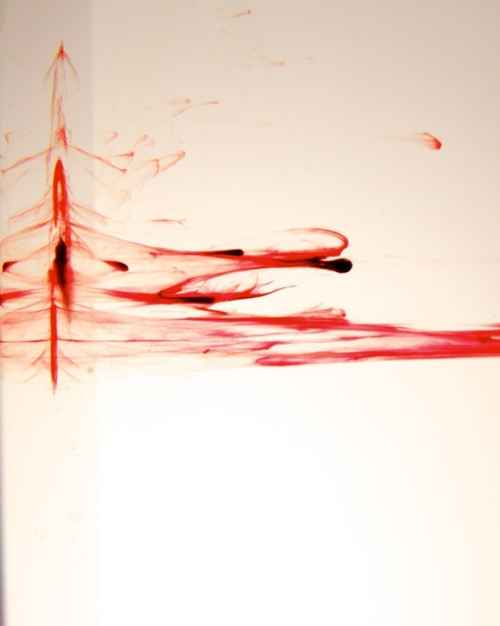
When his wife was being treated for menorrhagia, the idea for the paintings was born.
They are from a photo collection of her discharge in the toilet.
Menstruation is something that connects women the world over.
But it is still a taboo to talk about it.
This is a brave attempt to break that taboo!

Slide 4
What happens if you get your period in outer space?
Notes:
Zero gravity

Slide 5
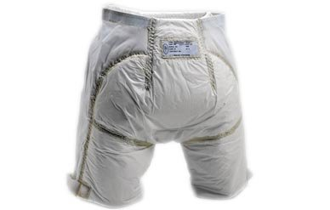
NASA Scientists prepare everything from refitting space suits to fit women to developing different toilet apparatuses to fit the female anatomy—but menstruation posed a unique problem.
Astronauts in space experience increased iron levels, which can be "extremely toxic because it is conducive to high oxidative stress”.
But menstruating women actually have an advantage in space because they lose iron.
Notes:
OCP

Slide 6
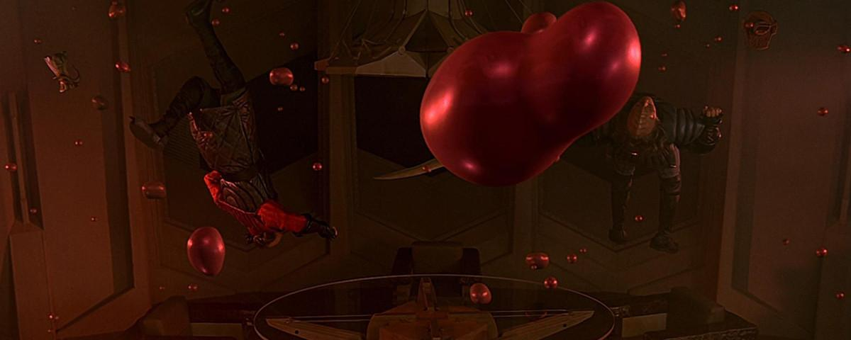
NASA scientists wondered
Whether the blood would stay lodged in the uterus
Or would it create blobs of free-floating blood?
More importantly, they were specifically concerned about the risk of retrograde menstruation.
Notes:
Non problem now. We will deal with it when it becomes a problem!

Slide 7
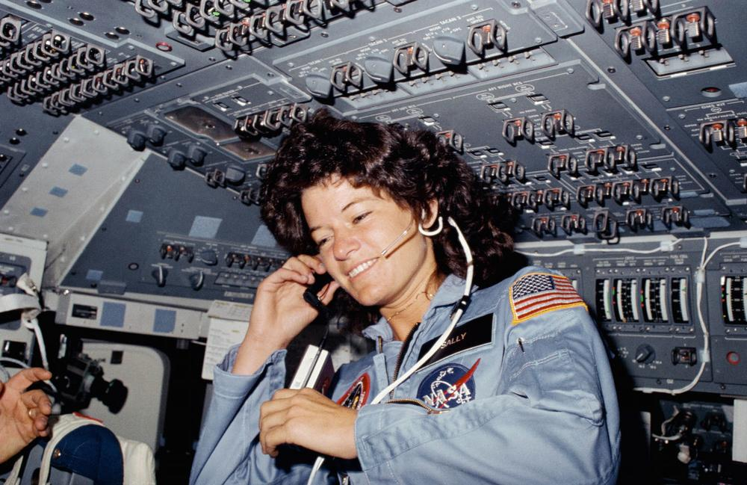
Sally Ride, the first woman to menstruate in space
Now, we know that zero-gravity menstruation is just like earthbound menstruation.
Notes:
Problem became a non problem

Slide 8
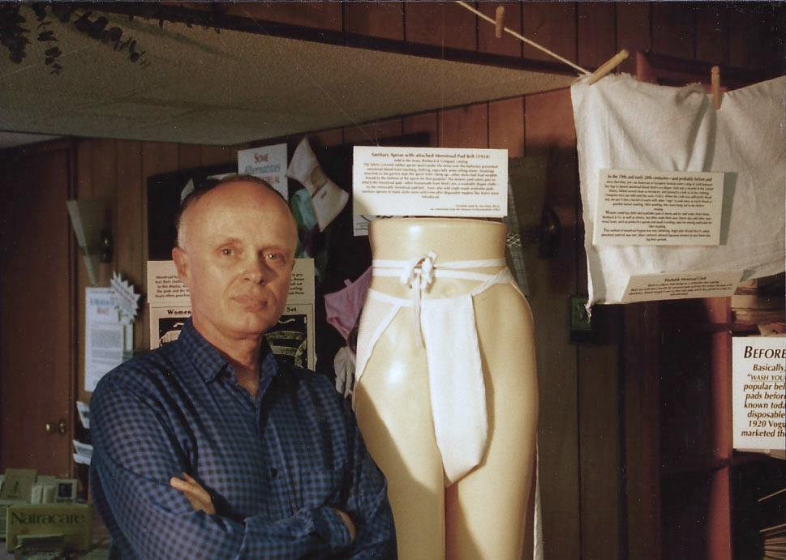
Do you know there was a Museum for Menstruation?
Harry Finley in Maryland USA

Slide 9
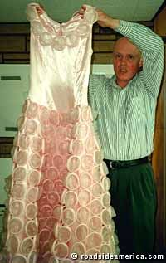
Harry Finley of Maryland created the World’s only treasure trove of menstrual memorabilia in his basement in 1994
It was a collection of ads and
items from 1920s
The chief attraction was a pink
dress made of menstrual cups
The museum was closed in 1998

Slide 10
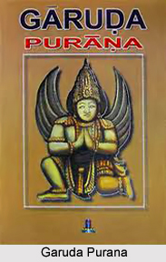
The Garuda Purana
is a Vaishnavaite text composed in the 1st millenium
It is an Encyclopedia
depicting almost
everything pertaining to that period
Notes:
We will change the topic because it is a taboo for men totalk about menstruation

Slide 11
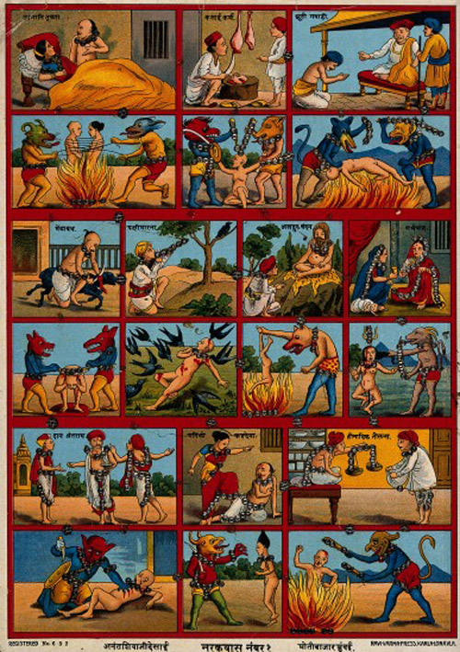
It predominantly deals with the consequences
of sin and what happens in hell
Notes:
Kick your husband or Ill treat PGs

Slide 12
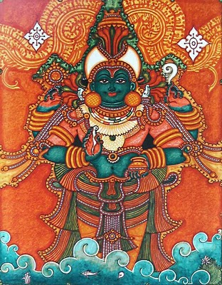
It also contains 72 chapters devoted to the Dhanvantri Samhita on Medicine which discusses the aetiology, pathology,
pathogenesis, manifestations,
diagnosis & treatment
Notes:
leach

Slide 13
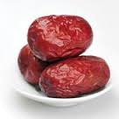
The description of embryology in Garuda Purana is incredible!
The mortal is formed in the middle 3 days the menstrual cycle when the male & female elements are bound together by the union of man & woman.
In 3 days it enters the womb
Becomes a lump in one night
Becomes round by 5th night
Resembles jujube fruit as an egg of flesh by 10th day
Head is formed by 1st month
Arms & other parts by 2nd
Bones, skin, genitals, cavities by 3rd
Seven bodily fluids by 4th
Hunger & thirst in 5th
Gains consciousness by 7th
Enveloped by a sheath, it moves to left
The creature at birth lies and moves like a worm in the disgusting
hollow of loin amid urine and feces
Notes:
Cardiac pulsations

Slide 14
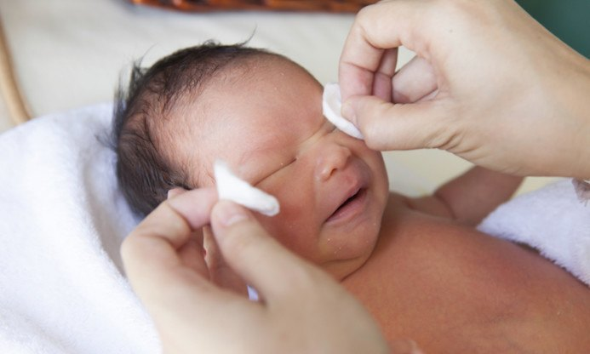
Vaginal Seeding – Now trending
Increasing numbers of new parents in the UK who deliver by caesarean section are requesting a procedure called 'vaginal seeding' or 'microbirthing'.
The procedure involves taking a swab from the mother's vagina and wiping it over the baby's mouth, eyes, face and skin shortly after birth by caesarean section.
Logic?
Swabbing the baby will boost its gut bacteria and reduce the risk of developing asthma, food allergies and hay fever in later life.
Notes:
Babies born by CS have an increased risk of Obesity, allergies, auto immune disease

Slide 15

Gut bacteria in infancy & Allergies
MJ
Maria Jenmalm
MJ
Low total diversity of the gut microbiota during the first year of life is associated with allergic diseases in infancy such as asthma, allergic rhinoconjunctivitis and eczema.
Low gut microbiota diversity in early infancy precedes asthma at school age
MC Jenmalm, Clinical & Experimental Allergy, 2016
70
70
*
**
**
25
20
20
40
40
CXCL10
CXCL10
15
CCR4
CCR4
Ratio of Th2- and Th1-associated chemokines
Ratio of Th2- and Th1-associated chemokines
5
5
Protective factors?
Protective factors?
Protective factors?
Protective factors?
ARC Est
Estonian
Allergic disease in
and Swedish children
c hildr en
c hildr en
children
children
The allergic march
The allergic march
Immune deviation during pregnancy
Immune deviation during pregnancy
SPT reactivity in
SPT reactivity in
Estonian
Estonian
and Swedish children
and Swedish children
House dust endotoxin levels
House dust endotoxin levels
vs
vs
at birth
at birth
vs
vs
allergy development to 2 years of age
allergy development to 2 years of age
during the first five years of life
during the first five years of life
during the first five years of life
bifidobacterial diversity at 1 week of age
bifidobacterial diversity at 1 week of age
MDC (CCL22) / IP-10 (CXCL10)
MDC (CCL22) / IP-10 (CXCL10)
Ratio
Ratio
30
30
35
*
*
p= 0 .0 0 7
p= 0 .0 0 7
*
*
35
35
SPT+ Sw
SPT+ Sw
EU/mg
EU/mg
25
25
30
Total Sw
*
*
30
30
carpet dust
carpet dust
60
60
*
*
20
20
25
25
50
50
*
γ
γ
IL-4 IL-10
IL-4 IL-10
15
15
IFN-
IFN-
20
AD Sw
*
15
15
Total Est
*
CCL22
CCL22
30
30
AB Sw
10
10
*
SPT+ Est
SPT+ Est
10
10
CXCR3
CXCR3
ARC SW
Prevalence (%)
Prevalence (%)
20
20
Sjögren Y
Sjögren Y
0
0
Voor T
No of bifidobacterial
No of bifidobacterial
6 mon
6 mon
by real-time PCR
by real-time PCR
species detected
species detected
24 mon
24 mon
Rhino-
Rhino-
Th2
Th2
Prevalence (%)
et al
et al
et al
10
0
5
, Clin Exp Allergy; In press
, Clin Exp Allergy; In press
3 mon
dermatitis
dermatitis
Atopic
Atopic
n
n
10
10
0
5
0
5
0
0
Str ic tly alle r gic
Str ic tly alle r gic
6 mon
3 mon
3 mon
via e g
via e g
7
7
Sandberg
Pediatr Allergy Immunol; In press
Sandberg
Pediatr Allergy Immunol; In press
0-1
0-1
progesterone
progesterone
12 mon
Age
Asthma
Asthma
Stric tly non-alle rgic
Stric tly non-alle rgic
et al
et al
Voor T
Voor T
MJ
MJ
MJ
conjunctivitis
MJ
MJ
MJ
26
Th1
MJ
MJ
12 mon
5 y
Age
et al
MJ
MJ
24 mon
5 yr
AD Est
AB Est
MJ
MJ
MJ
MJ
2
3-4
MJ
MJ
MJ
MJ
conjunctivitis
MJ
MJ
MJ
26
Th1
MJ
MJ
12 mon
5 y
Age
et al
MJ
MJ
MJ
MJ
2
3-4
MJ

Slide 16
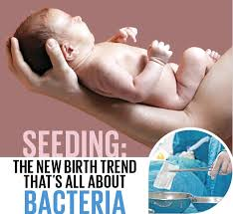
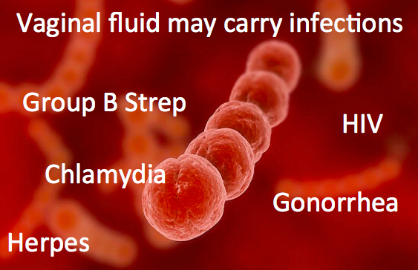
Not enough evidence to say vaginal seeding is beneficial
The risk is severe infections from exposure to potentially harmful bacteria such as group B streptococcus (carried by around 1 in 4 pregnant women) chlamydia, gonorrhoea and herpes simplex virus.
BMJ Editorial Feb 2016

Slide 17
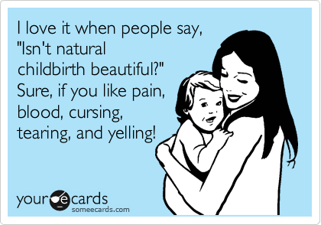

Slide 18
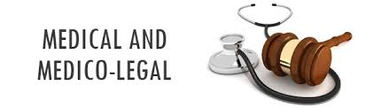
In 2015, UK Supreme Court awarded in a landmark case, damages for a baby who sustained brain damage during natural vaginal birth
The mother had a higher than usual risk of having a difficult birth, due to having a small pelvis and diabetes
But doctors didn’t inform her of these increased risks– an act of “medical paternalism”

Slide 19
The risks of natural birth
Women who deliver after 30 years have a higher risk of major pelvic floor injury that can lead to incontinence
For every extra year at age of first childbirth, the risk of injury to pelvic floor muscles rises by 6 %
The risk of uterine prolapse is 10 % for a 20-year-old delivering vaginally without the use of instruments like forceps
This doubled to 20 % for a 40-year-old.
Mother who has her first child at 38 has a 15 % chance of an anal tear
-American Journal of Obstetrics and Gynecology
Notes:
Aishwarya

Slide 20
Some in RCOG argue that information leaflets won’t be enough, and that women planning a vaginal birth should sign an informed consent form that details the risks, just as with any surgical procedure
-New Scientist July 2016

Slide 21
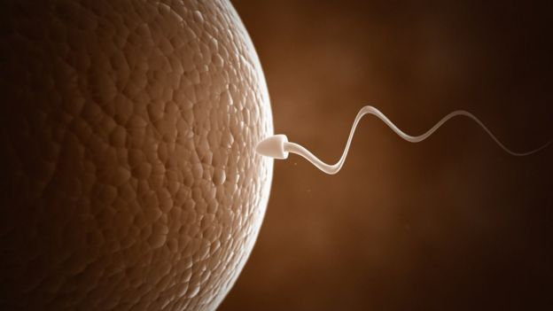
Do we really need both a man & a woman to make a Baby?

Slide 22
Tony Perry of Bath university has demonstrated for first time that sperm can fertilize cells other than ovum
Ordinary cells can be combined with a sperm so that an embryo is formed
In other words, two men could have a child, with one donating an ordinary cell and the other, sperm.

Slide 23
Or one man could have his own child using his own cells and sperm ( The child being more like a non-identical twin than a clone)
Chinese scientists have already made sperm from stem cells and then fertilise an egg to produce healthy mice
Viable ova could be derived from skin cells of a woman – Nature Oct 2016
Combining these two methods we may eventually do without sperm and eggs altogether

Slide 24
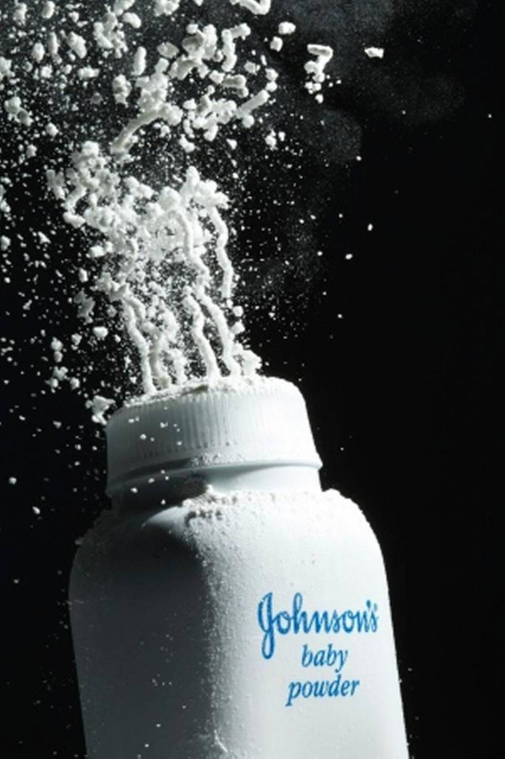
Lets “Talc” about Ovarian cancer
Do you know talcum powder can cause Ovarian Cancer?
A jury in St. Louis, USA awarded $72 million to the family of a woman who died from ovarian cancer in October 2015
She claimed that the cancer was caused by her regular use of Johnson & Johnson baby powder and other products containing talcum

Slide 25
Since the early 1970s, British scientists have found talc particles in 13 ovarian cancers
Talc contains asbestos, a known carcinogen. But, asbestos is not used in US now.
A 1999 report concluded that talc use could be the cause of about 2,000 cases of ovarian cancers in USA each year
1200 ovarian cancer claims filed over the last two years against Johnson & Johnson and Imerys Talc America.
American Cancer society’s results are mixed & inconclusive

Slide 26
Views of Male Obstetrician-Gynecologists in our profession
The first annual Contemporary OB/GYN Labor Force Survey – March 2016
Emphasizes the shifting gender dynamics in our profession in the West
More women than men are entering the profession
Here are the men’s opinions:
Notes:
South india-cd count the no of male obg with fingers on left hand-fair share ofinsults innuendos,humiliation-water fish

Slide 27
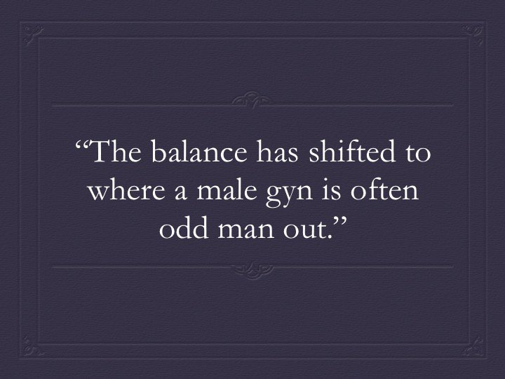

Slide 28
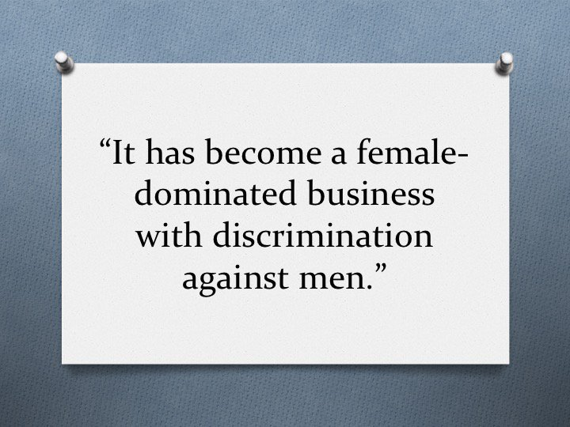

Slide 29


Slide 30
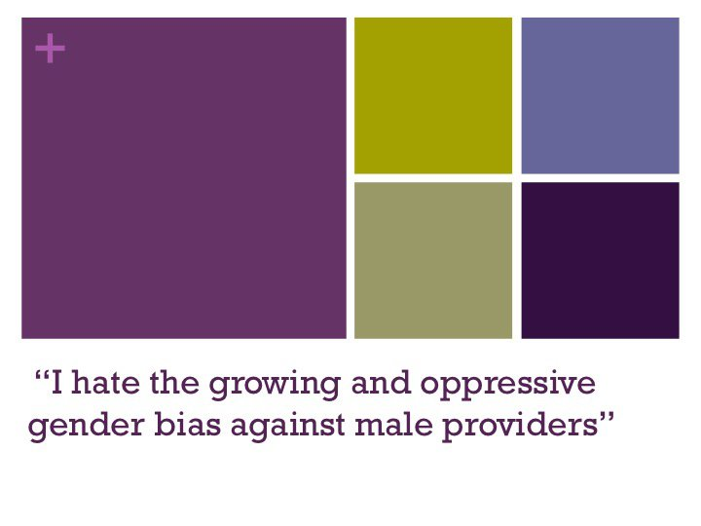

Slide 31
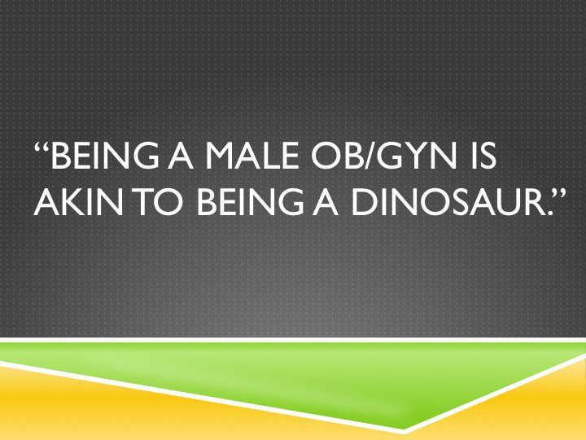

Slide 32
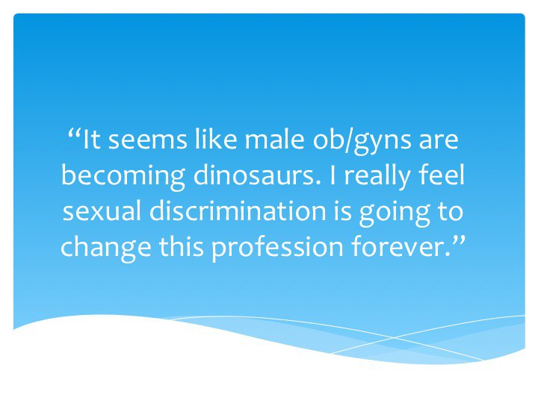

Slide 33
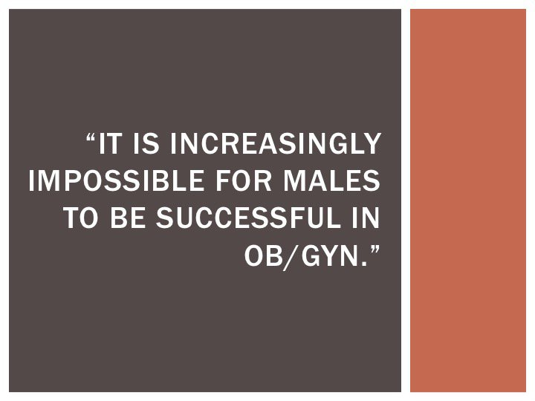

Slide 34
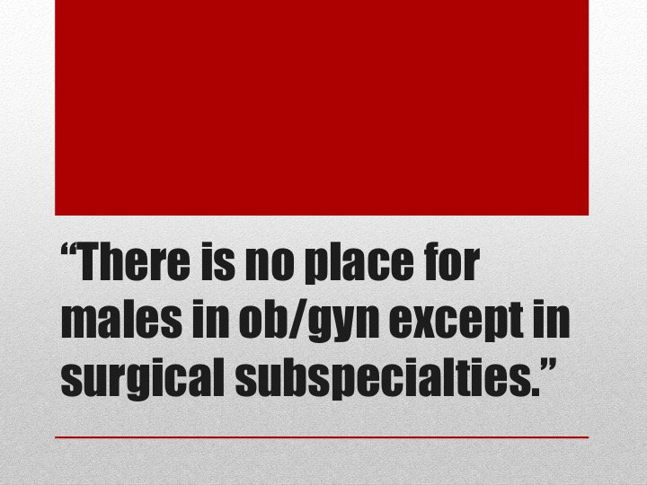

Slide 35
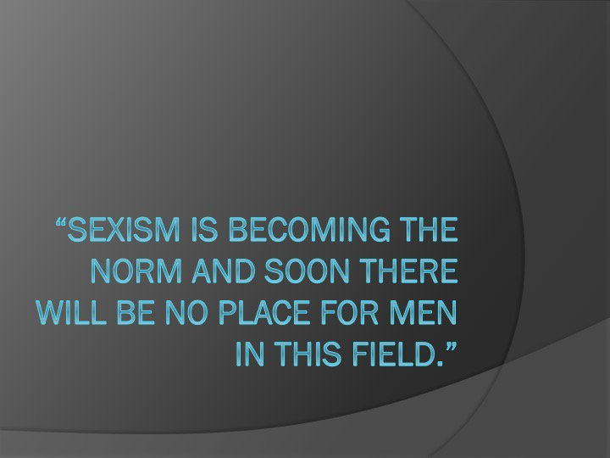

Slide 36
Thank you!

