Slide 1
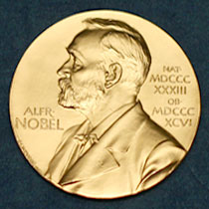
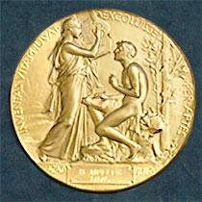
ObG Watch
October 2017
Dr Narayanan
Notes:
For those of you in the audience who aspire for the Nobel prize, this is what the medal looks like!

Slide 2
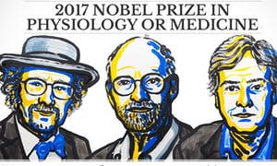
Nobel prize 2017 for medicine was awarded for insights into internal biological clock of living organisms
£825,000 prize shared between American scientists Jeffrey C Hall, Michael Rosbash and Michael W Young

Slide 3
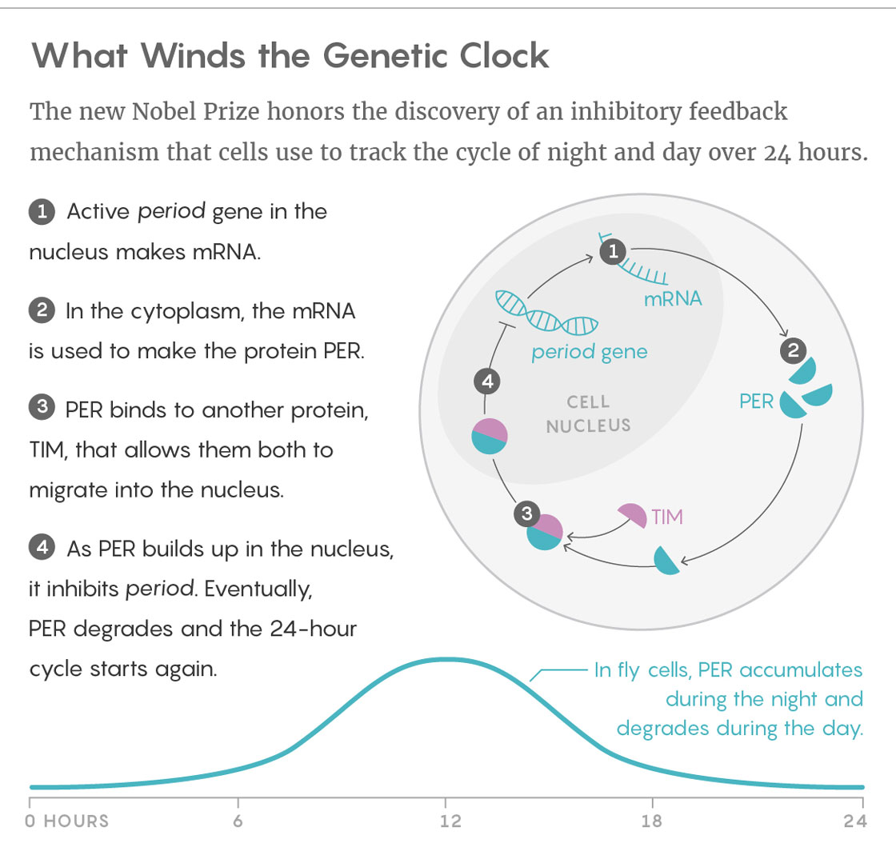
Notes:
Cycle corresponds to the rotation of earth.

Slide 4
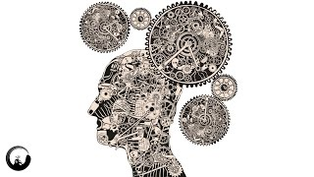
The clock regulates critical functions such as behavior, hormone levels, sleep, body temperature, blood pressure and metabolism.

Slide 5
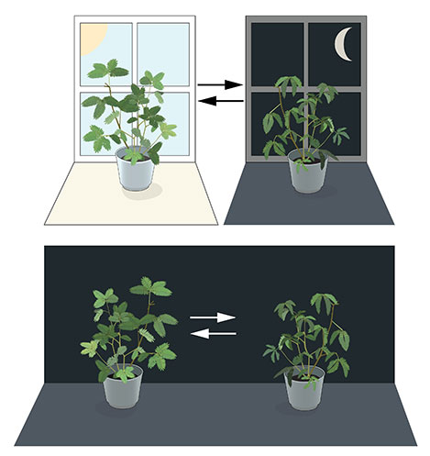
Unraveling the Clock
First recognition of diurnal rhythms came from the 4th century BC. Androsthenes described the daily leaf movements of the tamarind tree on the island of Tylos (now Bahrein) in the Persian Gulf during the marches of Alexander the Great .
The leaves of the mimosa plant open towards the sun during day but close at dusk
In 1729 Jean Jacques d'Ortous de Mairan placed the plant in constant darkness
The leaves continue to follow their normal daily rhythm.
Notes:
Unprouncible name - endogenous

Slide 6
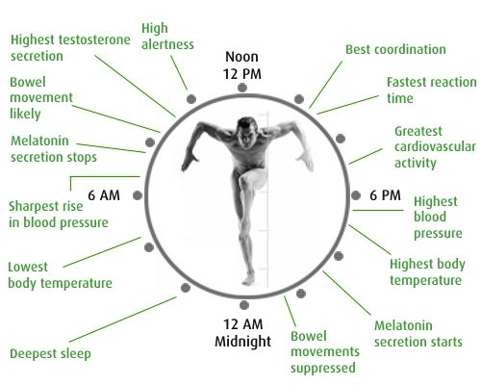
The circadian clock anticipates and adapts our physiology to the different phases of the day
Notes:
Dynamic hormone from pineal gland with diverse functions – schedule surgeries

Slide 7
Impact on Menstruation
Disturbed circadian rhythm leads to altered hormone release
Decreased Melatonin, advanced TSH, delayed Cortisol
Depression, mood changes, sleepiness during day & disturbed sleep at night
Causes PMDD & PMS
Notes:
If you are sleeping during this presentation - Pre Menstrual Dysphoric Disorder

Slide 8
Non pharmacological Therapies
Phototherapy:
Exposure to bright white light in the evenings
Sleep deprivation

Slide 9
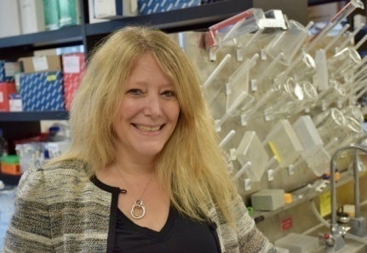
Impact on Heart
A healthy circadian rhythm protects heart from cardiomyopathy & Heart attacks
Tami Martino employed mice with a genetic mutation in the cells that disturbed the clock
Male mice suffered more heart attacks than the females
When ovaries were removed heart attacks increased in female mice
Notes:
Female not a cause of heart attacks

Slide 10
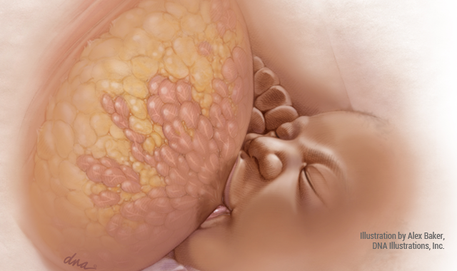
Breast milk is the Best milk
Human milk contains a balance of nutrients and bioactive components that are vital for healthy brain development & physical growth of the infant. It provides a variety of immune- protective and maturation factors that are beneficial for the development of infant`s immune system
Notes:
No disputing the fact

Slide 11
Lesser known facts
Milk from mothers of boys have 25% greater caloric content
The water content adapts to fulfill the liquid demands
The highest DHA concentrations found in coastal populations.
Eating Fish influences the amounts of docosahexaenoic acid (DHA) in human milk.
Dietary vitamin C correlates with and human milk concentrations of vitamin C
Vitamin D or immune components vary depending on seasonal factors.
Anti-pathogenic compounds in the milk are linked to infant pathogen risks associated with the specific environment

Slide 12
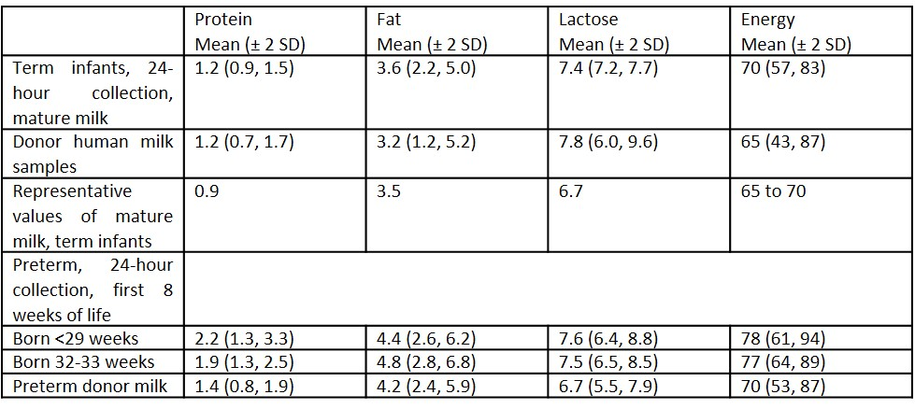
Macronutrient (g/dL) and energy (kcal/dL) composition of human milk

Slide 13
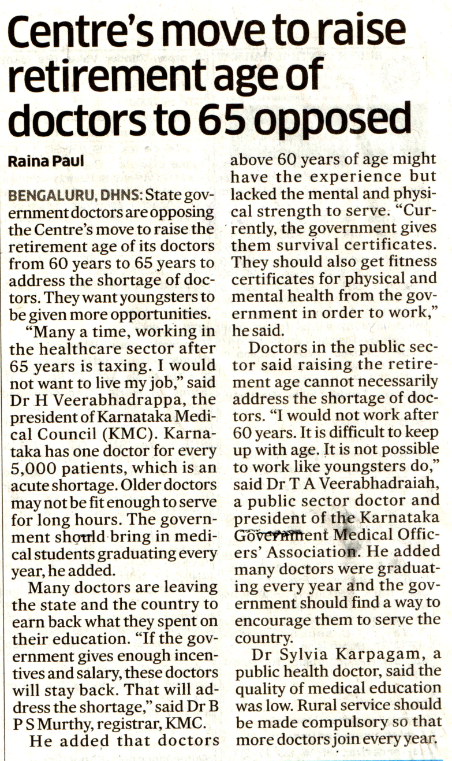

Slide 14
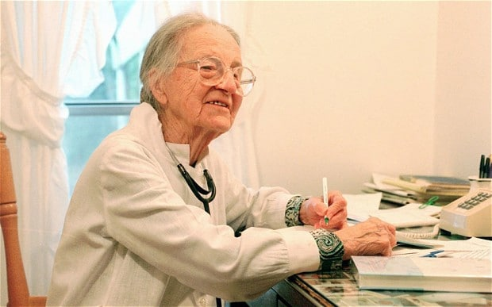
The oldest ever practising doctor was Dr Leila Denmark ,a paediatrician from Georgia, United States, as recognised by the Guinness World Records.
When Dr. Leila Denmark (b. 1 February 1898, Portal, Georgia, USA) retired in May 2001, aged 103, she was the oldest practicing physician ever. Ten years later, at 113, Dr. Denmark is also the oldest person to have held the title of “Doctor.”

Slide 15
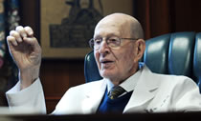
Oldest Practicing ObG - world record set by Dr Walter Watson in 2010
Dr Walter Watson, known to many as “Papa Doc”, has delivered 18,000 babies in his 100 years of life – At the age of 102 years
He was still coming into the clinic regularly.
Notes:
Our own Dr sita Bhateja

Slide 16

Dr Balwant Ghatpande
Pune’s 102-year-old doctor works 10 hours a day, 7 days a week

Slide 17

New life for old obstetricians
As age increases, ob/gyns drop the ob part of their practice because of numerous challenges: long and erratic hours, expensive malpractice risk, the unpredictability of labor and delivery, interference with scheduled elective surgeries and loss of any semblance of normal family life.
Appointed as “laborists,” or ob/gyn “hospitalists” they are physically present in shifts to respond to all ob and gyn emergencies
They triage all incoming ob patients and are responsible for all unassigned laboring patients.
They assist with surgeries, do patient rounds, teach, consult, and are available for emergencies.
Notes:
April issue

Slide 18
The Positives
Increases patient safety, reduces bad outcomes, lessens malpractice situations, shortens hospital stays and increases patient satisfaction.
> 15% reduction in CS rates & decline in induction of labor and preterm deliveries.
2000 ob/gyn hospitalists across the USA offer a better quality of life for private obstetricians.
It allows the wealth of knowledge and experience from an older group of physicians to be leveraged rather than lost
Notes:
vacancy

Slide 19
Karnataka
Worst Triglycerides in country
Among 4 states with worst LDL cholesterol levels-2nd highest
Third highest in Diabetes
3rd Highest male smokers (1 in 5)
97% mothers start complementary feeding < 6months
-National Instt Nutrition, H’bad
Notes:
Depressing statistics-better during dying days of 2017 than

